Slide 1
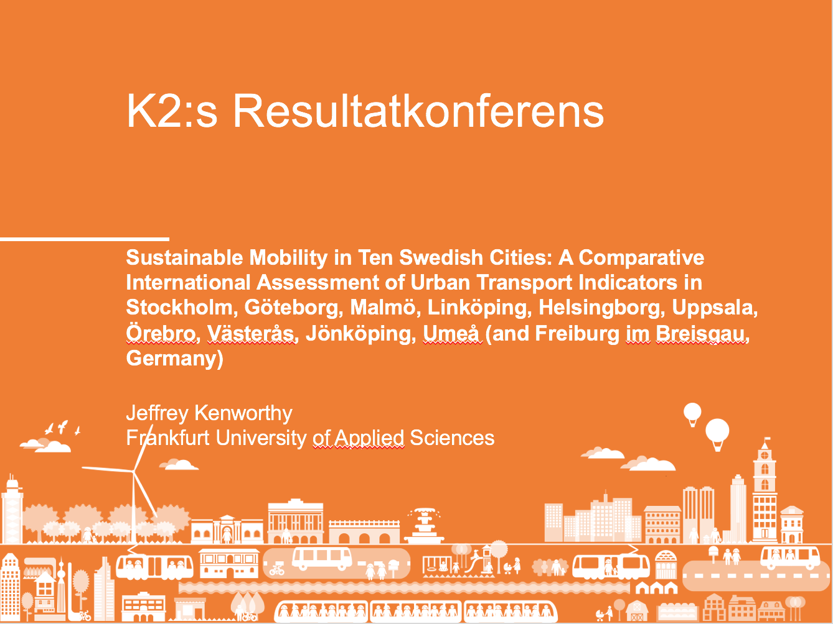

Slide 2
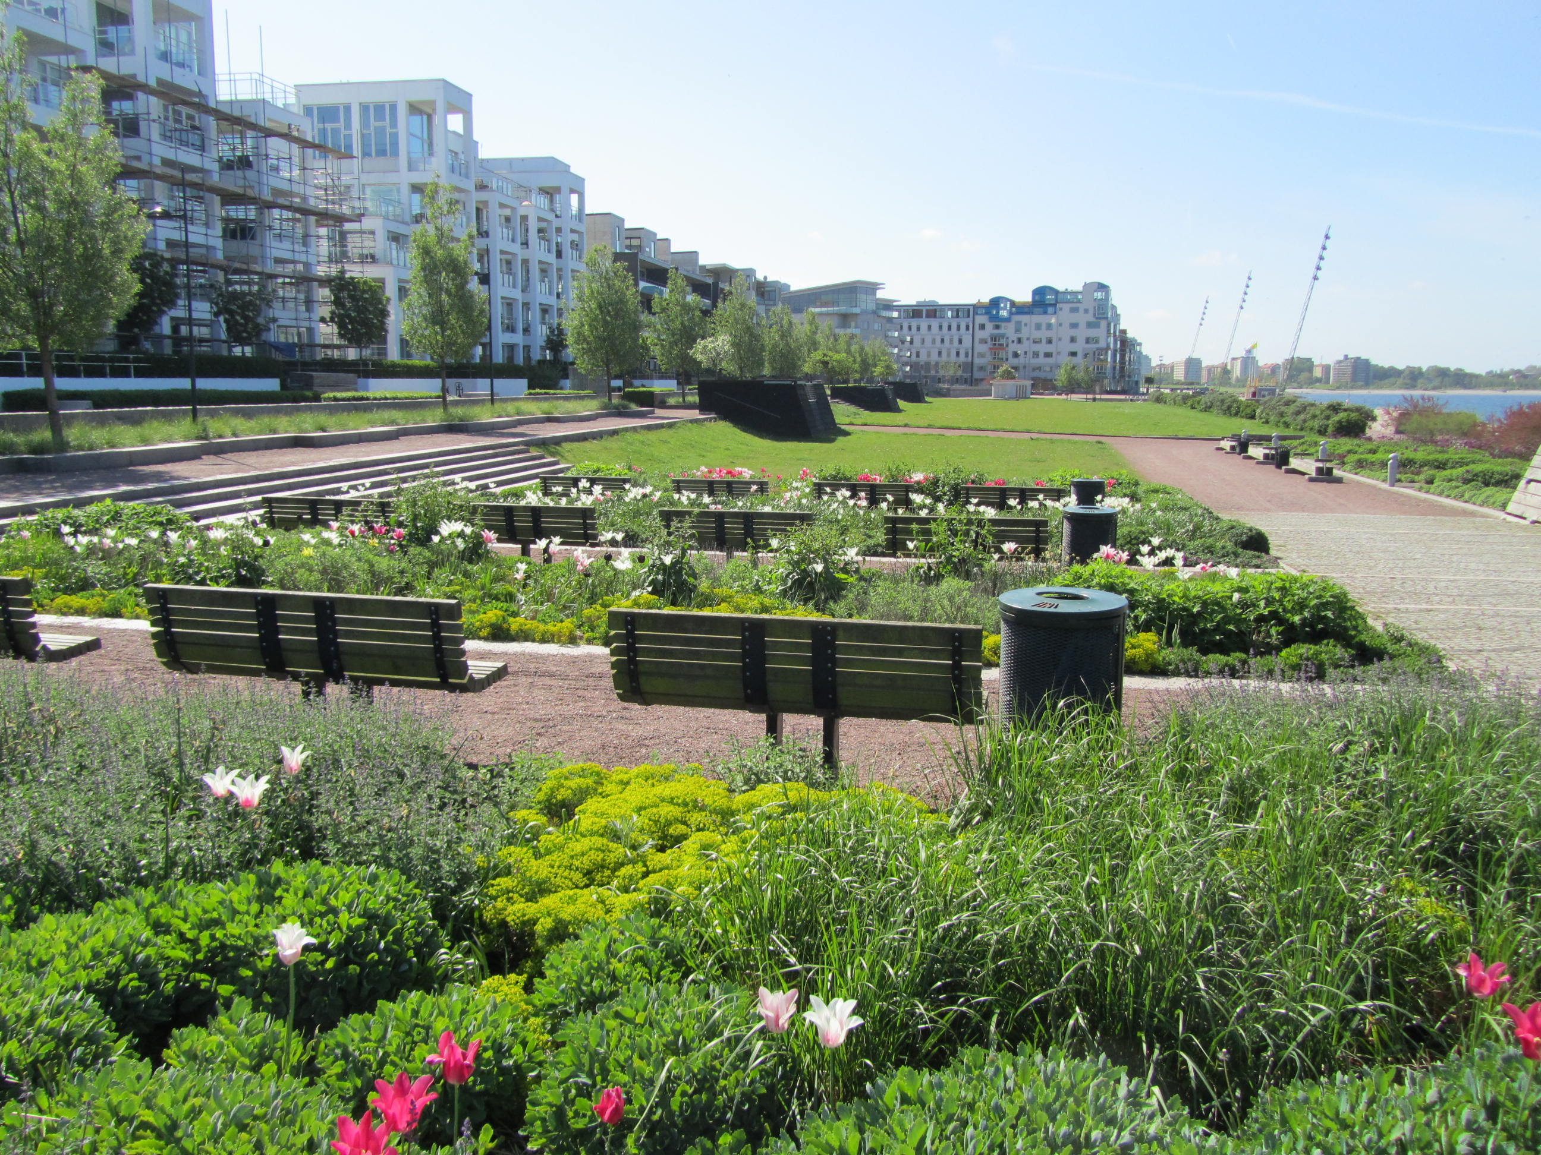
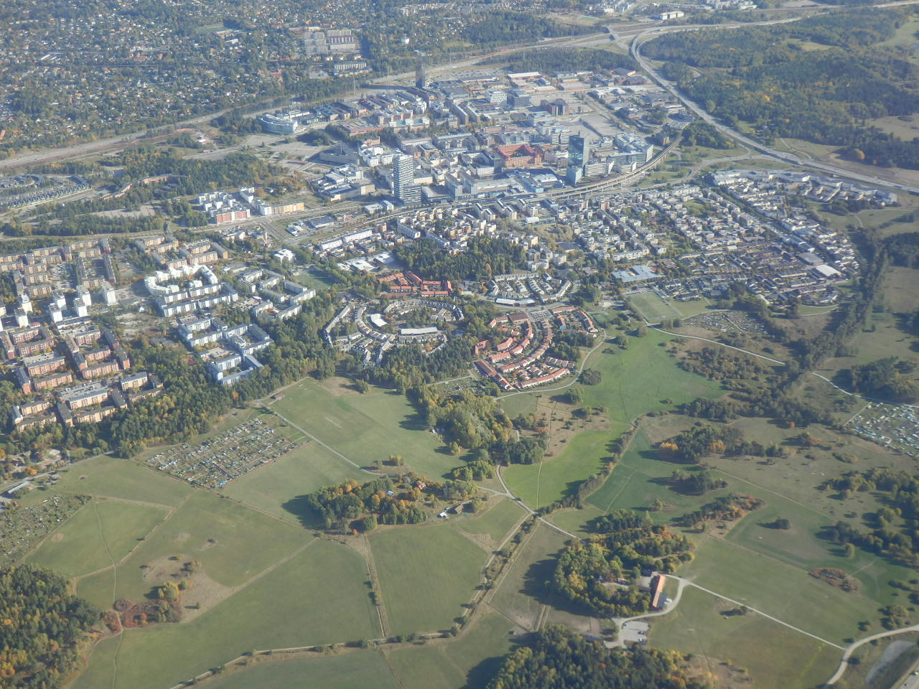
Sustainable Mobility in Ten Swedish Cities: A Comparative International Assessment of Urban Transport Indicators in Stockholm, Göteborg, Malmö, Linköping, Helsingborg, Uppsala, Örebro, Västerås, Jönköping, Umeå (and Freiburg im Breisgau, Germany)
Results from two K2 Funded Small Research Grants
By Jeff Kenworthy
Frankfurt University of Applied Sciences
Presented to: K2 results conference April 23, 2019
On-line Conference, Sweden

Slide 3
DATA COLLECTED

Slide 4
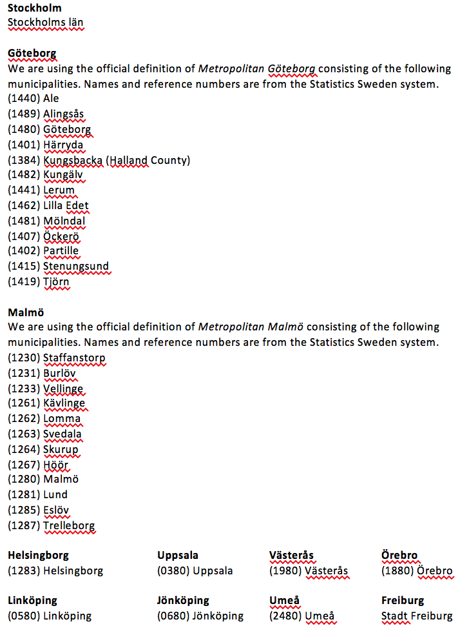
DEFINITIONS OF SWEDISH CITIES AND FREIBURG IM BREISGAU
The five smaller Swedish cities plus Freiburg im Breisgau

Slide 5
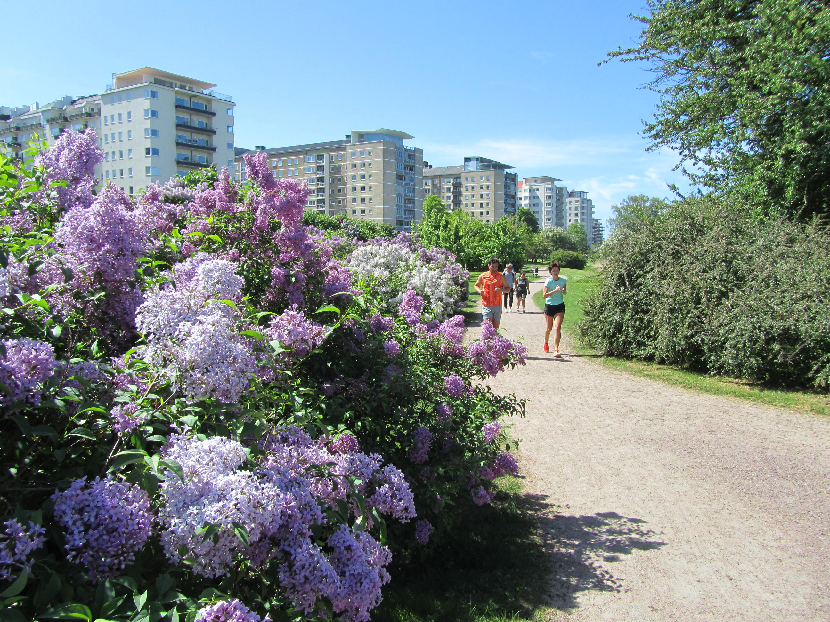
Sweden’s largest five cities (referred to here as SWE LARGE 2015) are 43% higher in density than the next five biggest cities (SWE SMALL 2015). However, this is only the difference between 20 and 14 persons per ha so all are in the lower density category, especially for European cities. FREIBURG, my benchmark small European cities is 46 per ha or 2.7 times denser than the average Swedish city.

Slide 6
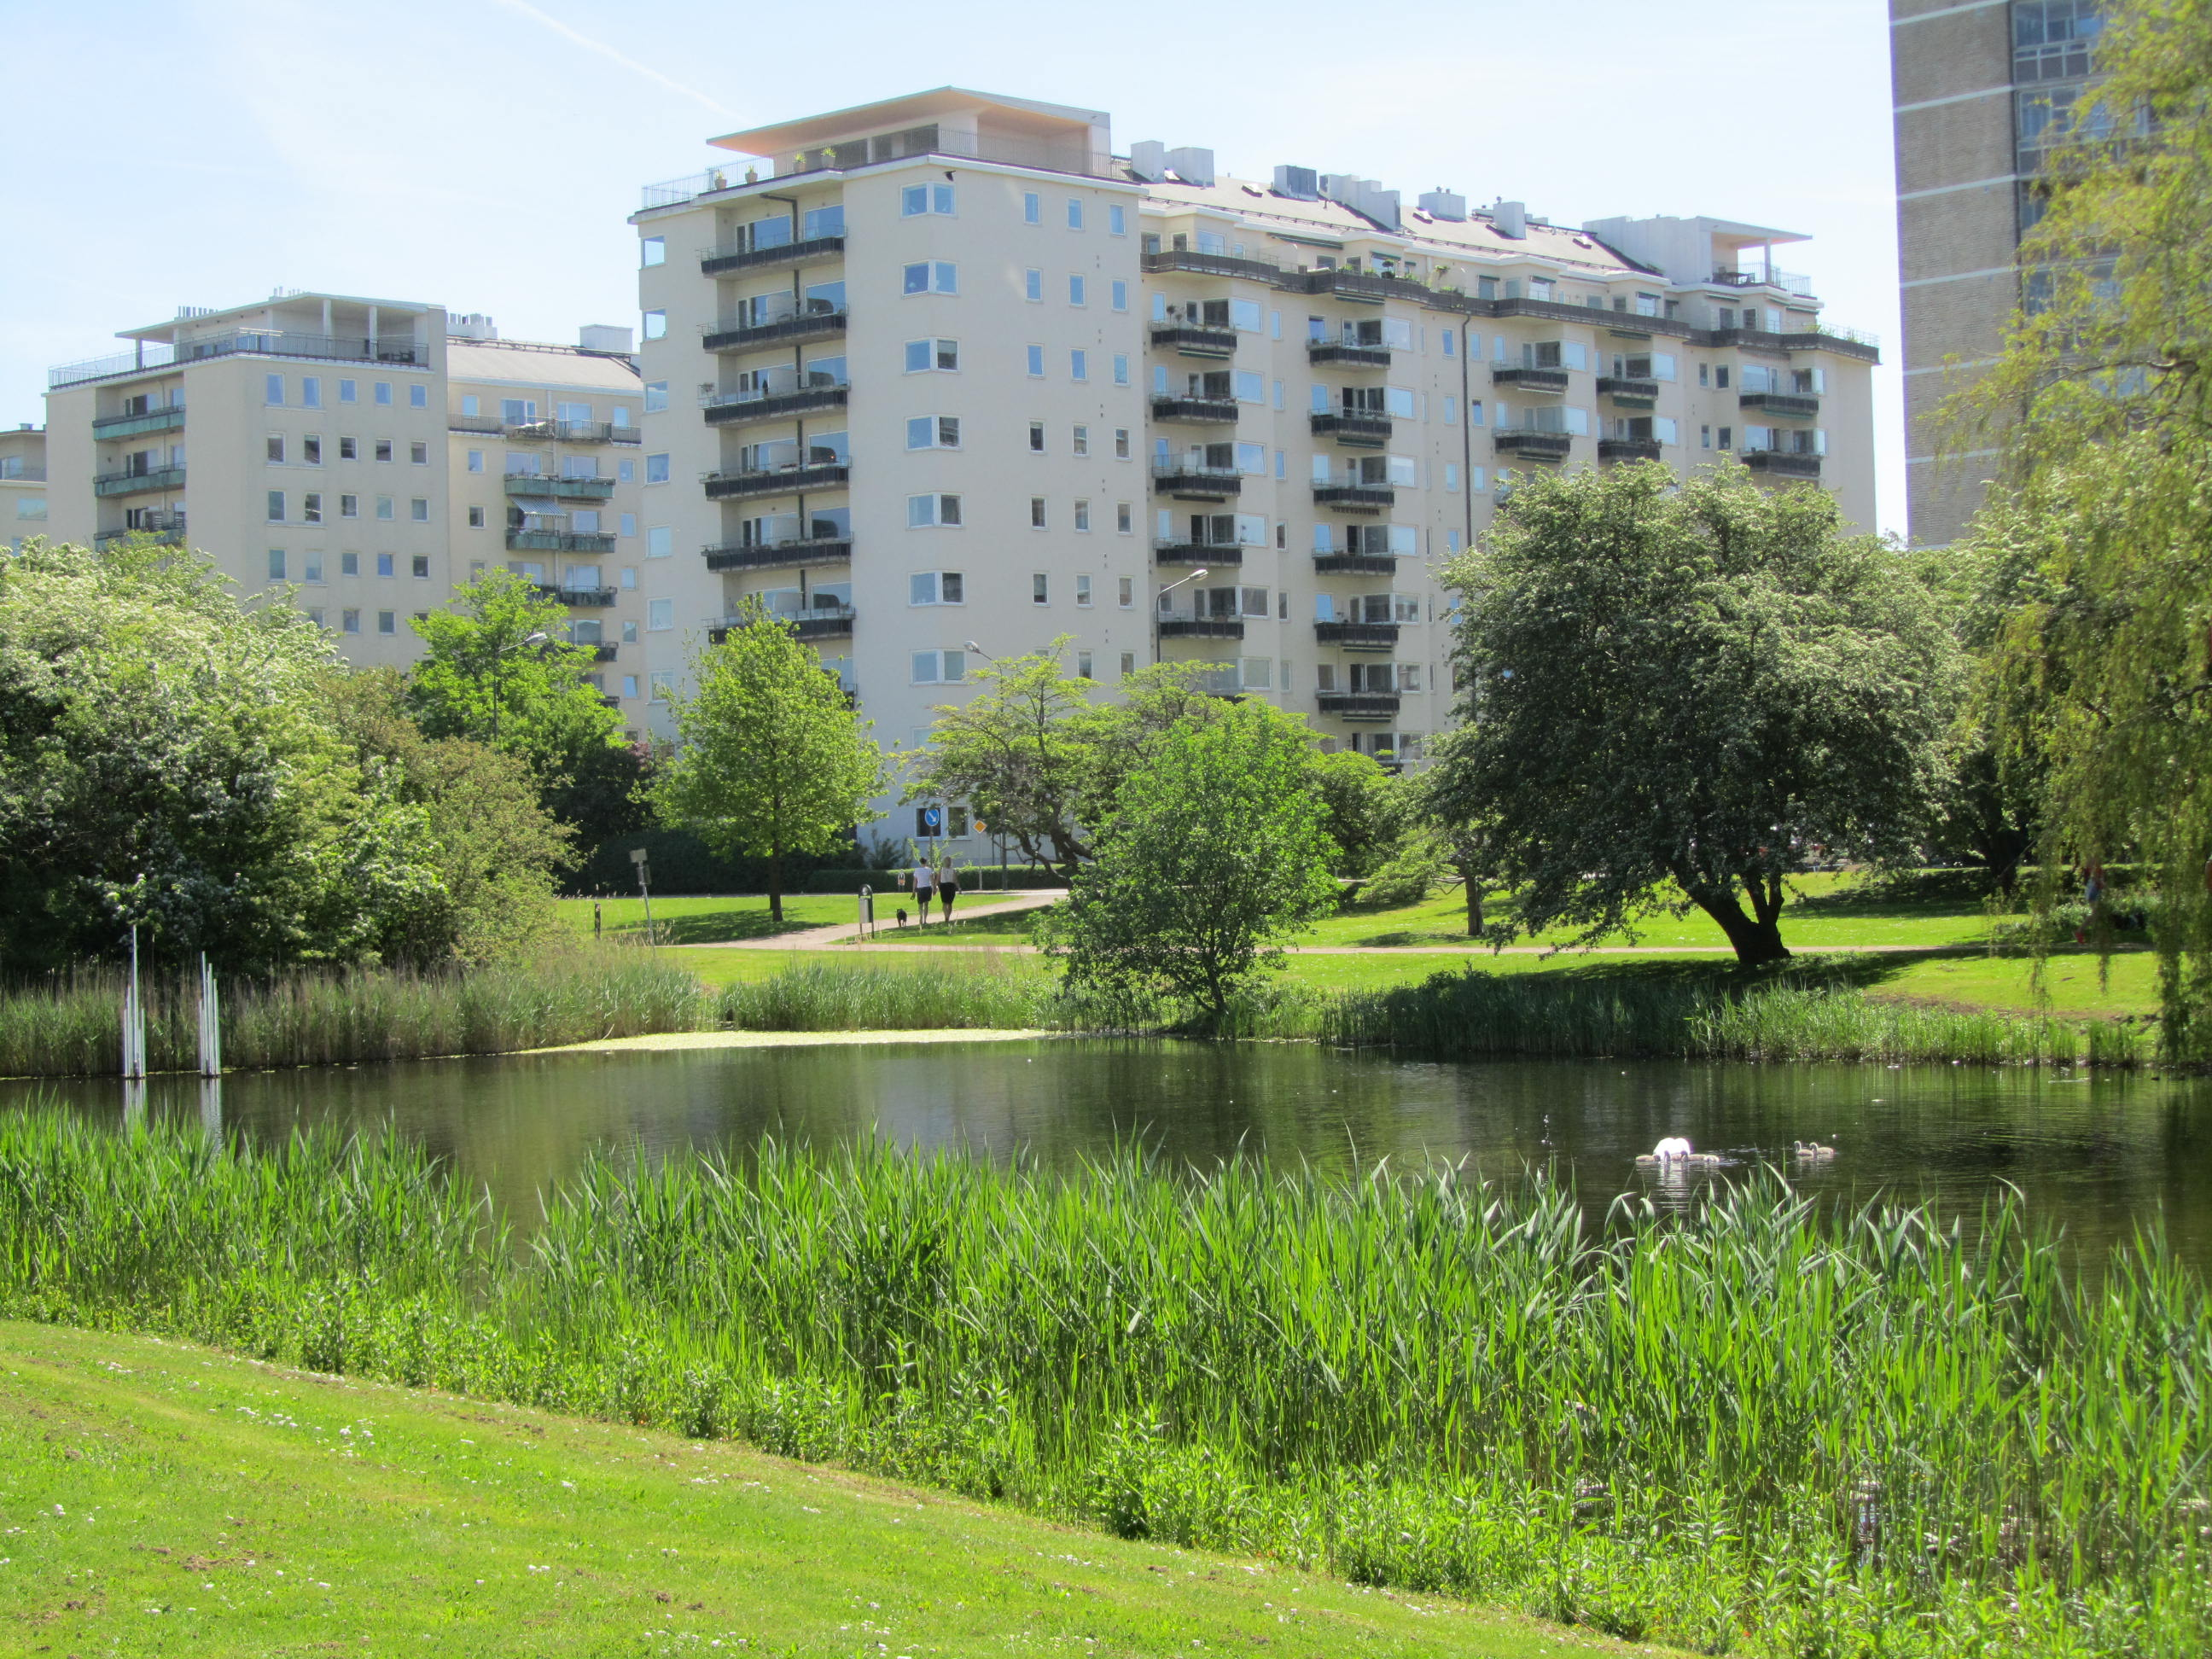
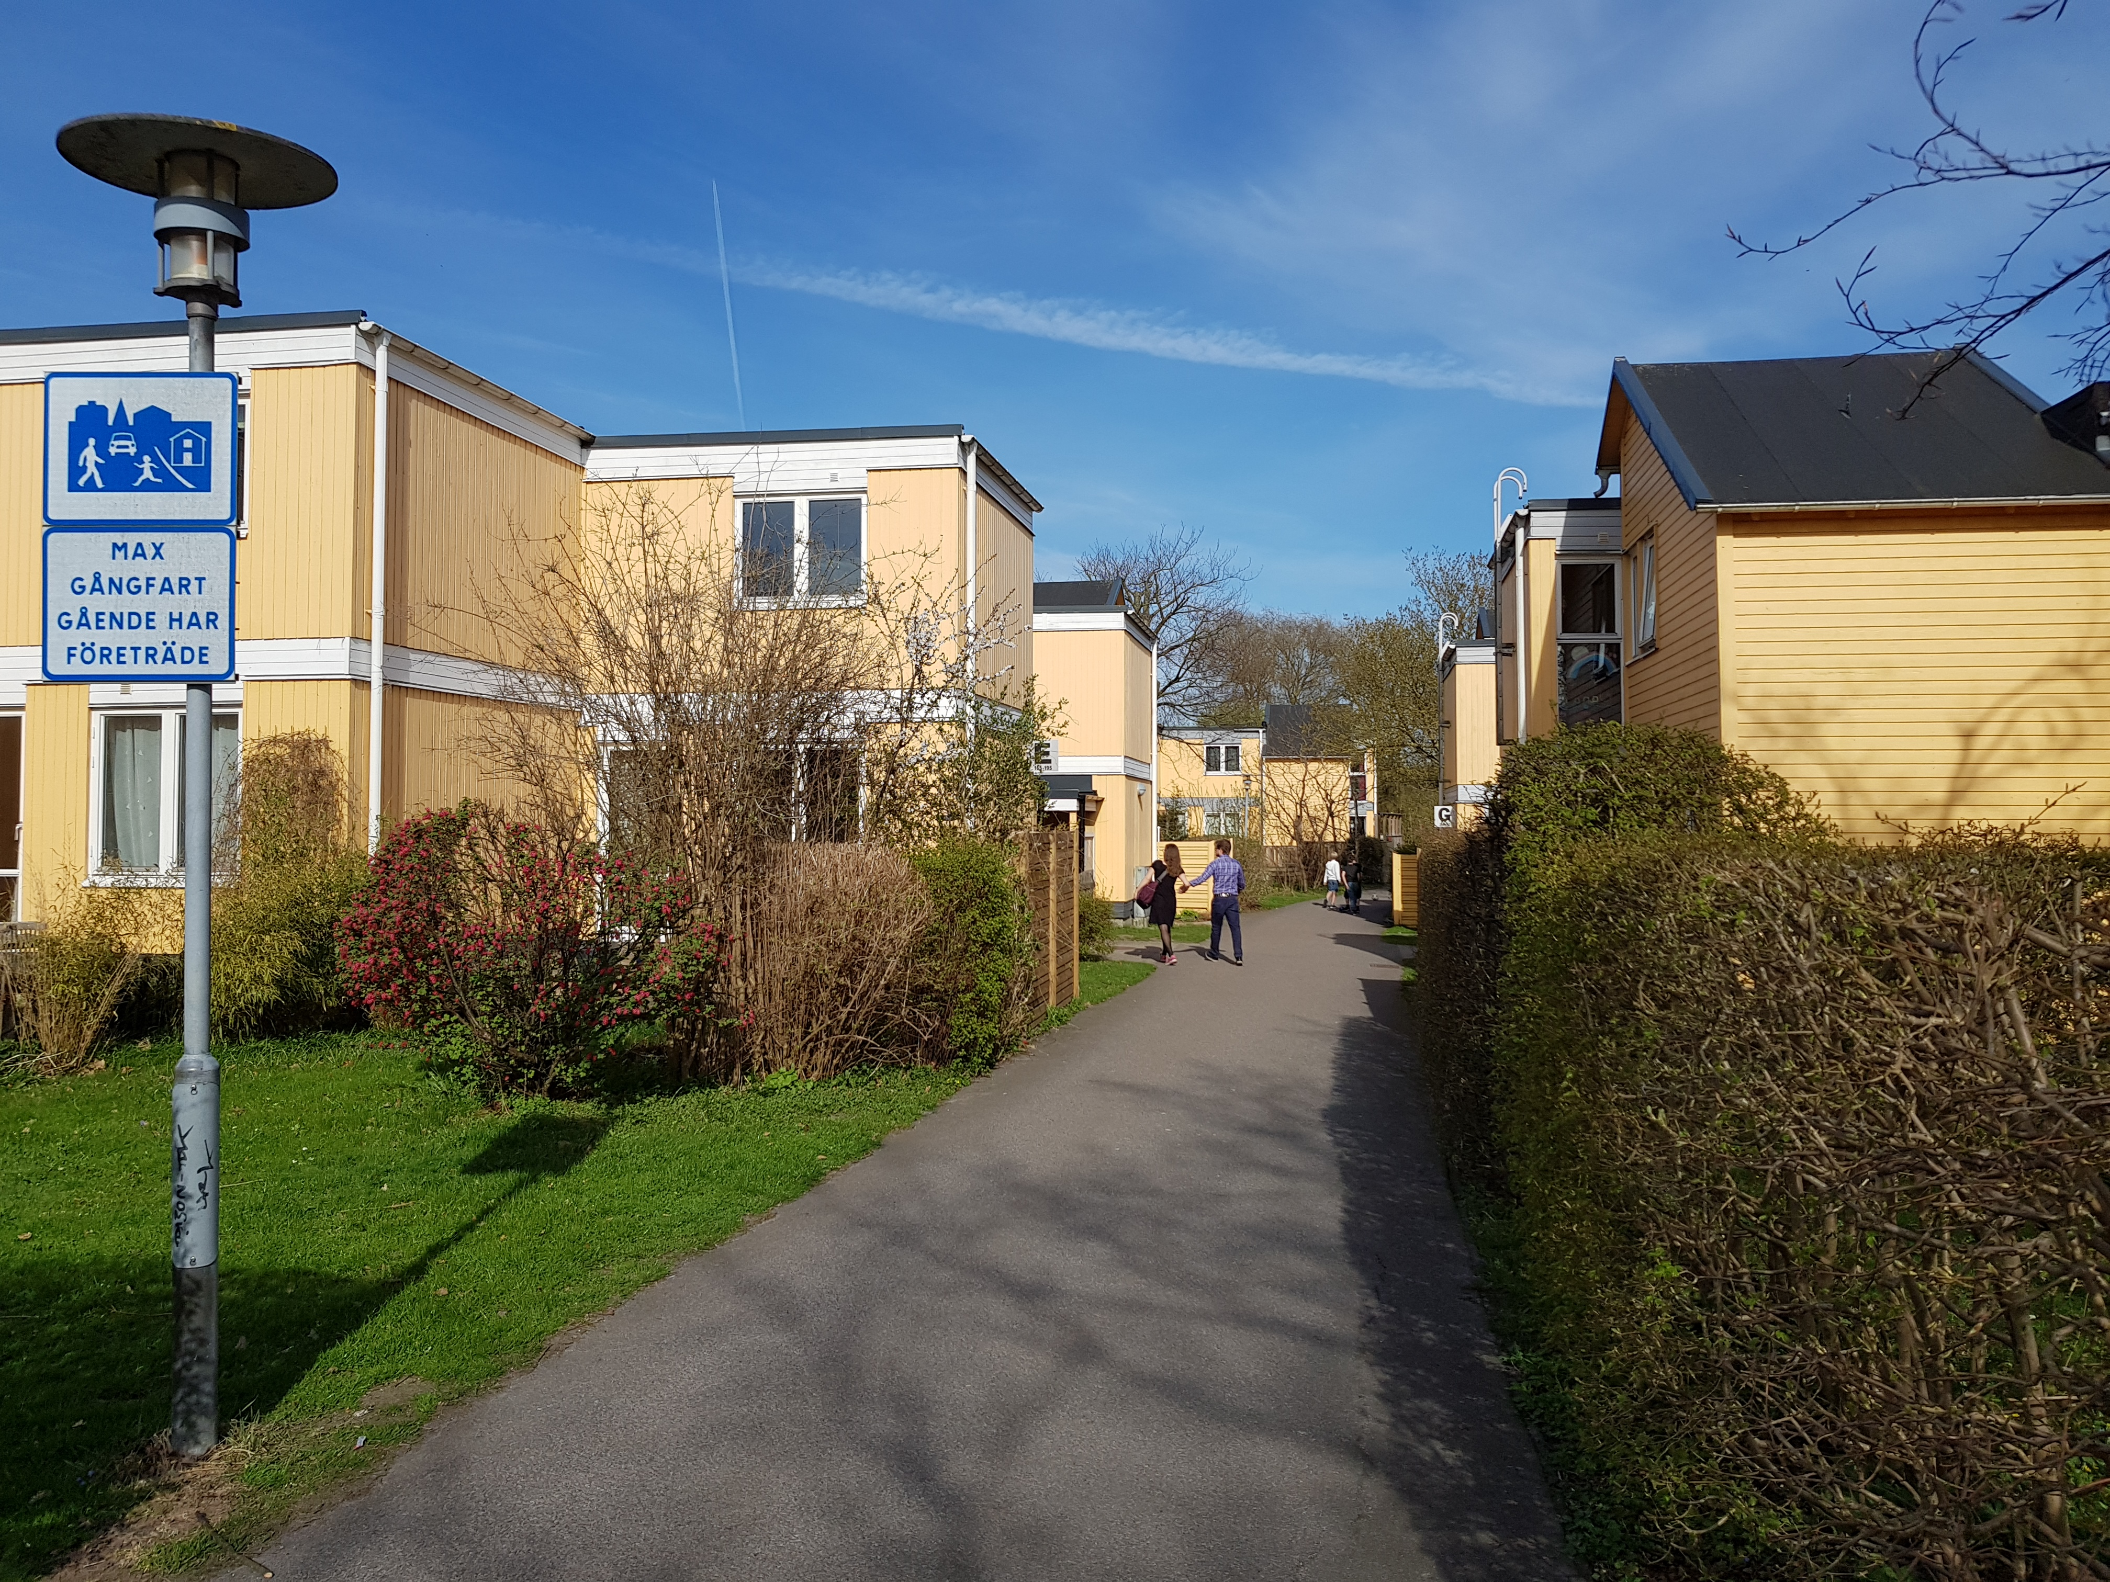
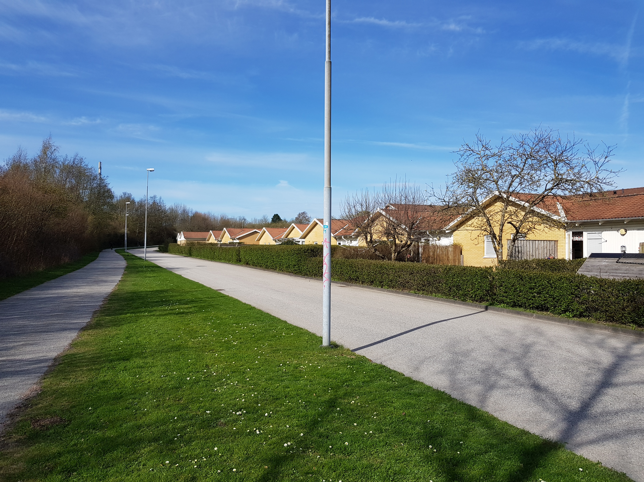
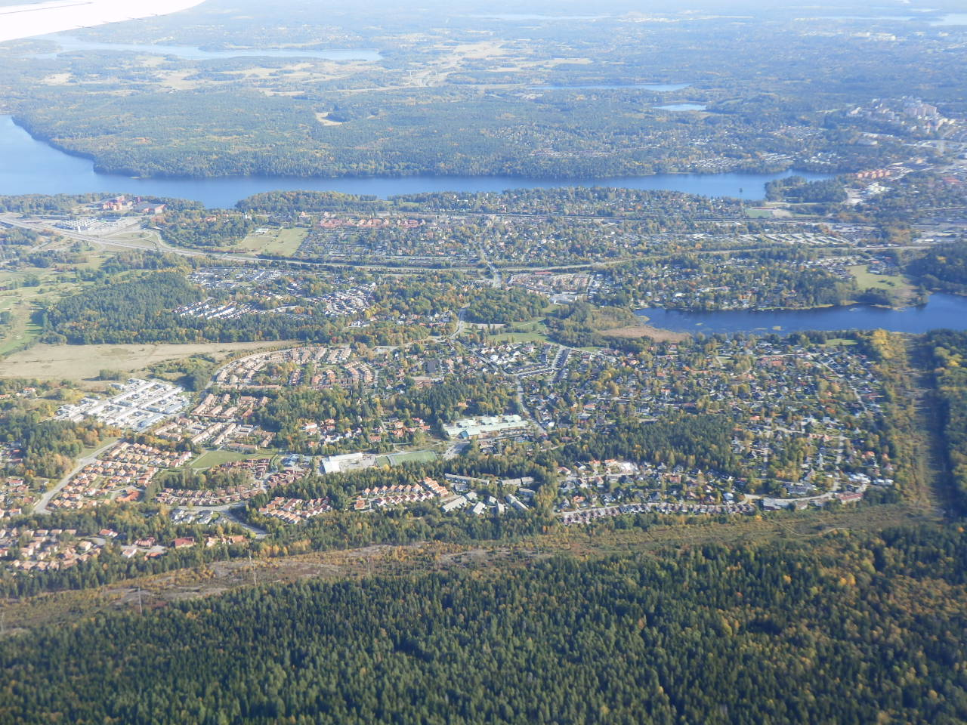
Swedish cities present a wide range of density which results in lower densities than typical European cities

Slide 7
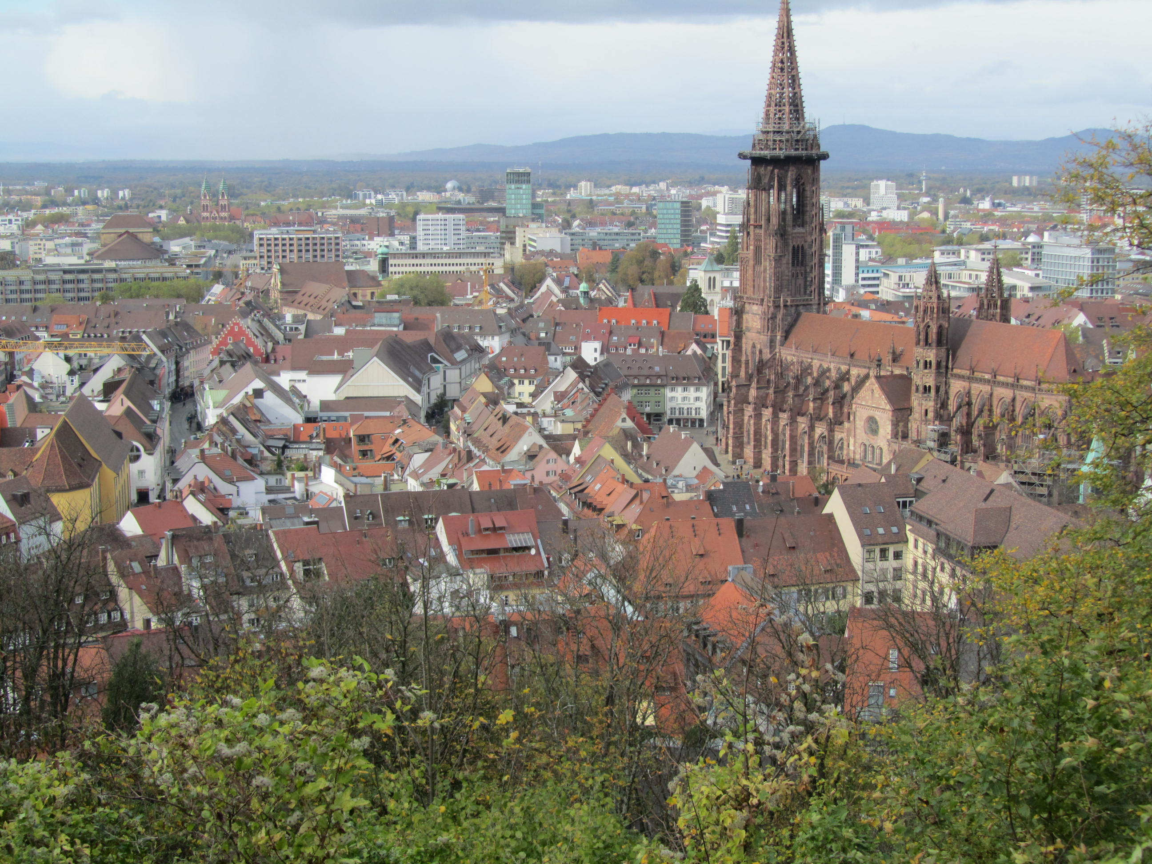
Swedish cities are comparatively centralised in work being very similar on average to European cities. The smaller cities are more centralised in work in their CBDs (18.3% of jobs) compared to the larger cities (16.3%) with little difference to Freiburg. The range is big (7.0% in Göteborg and 27.2% in Stockholm).

Slide 8
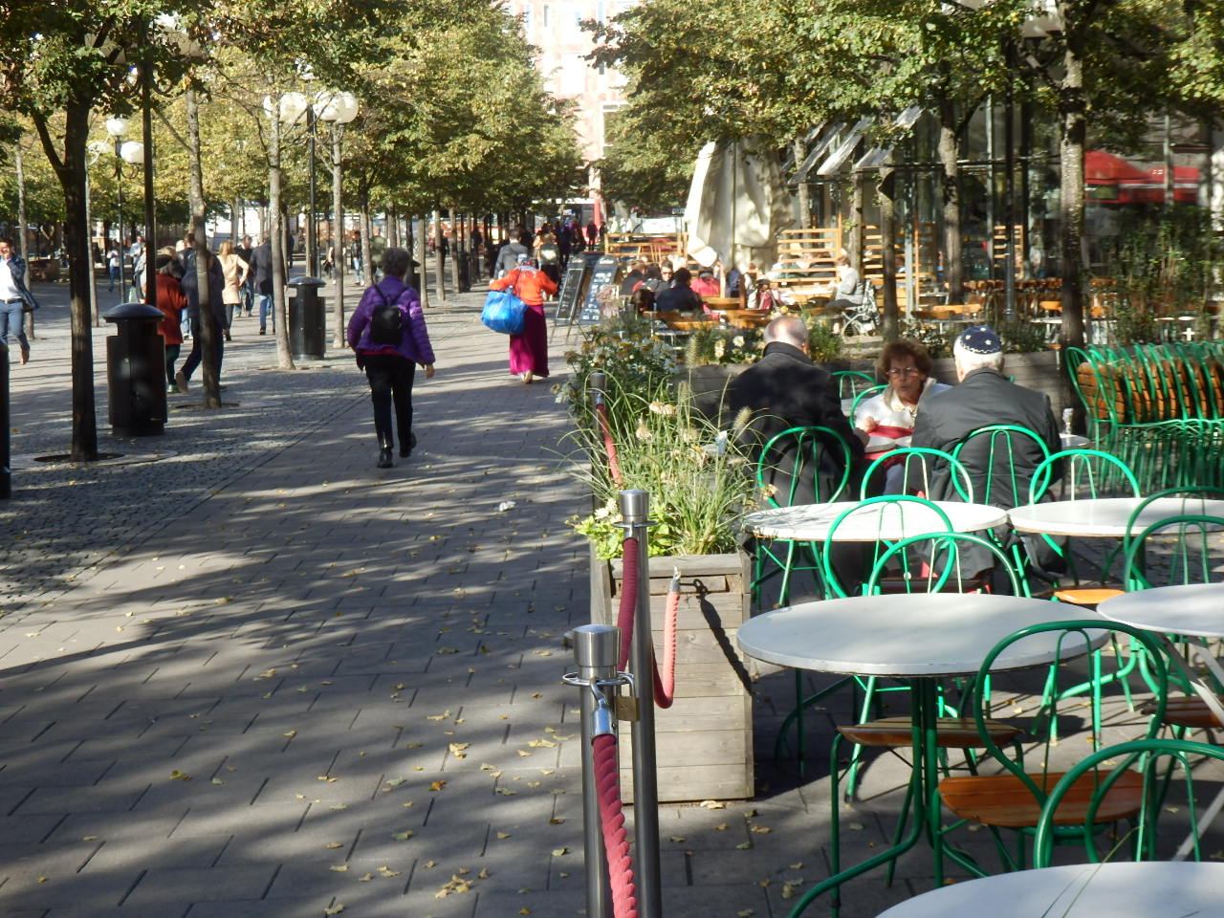
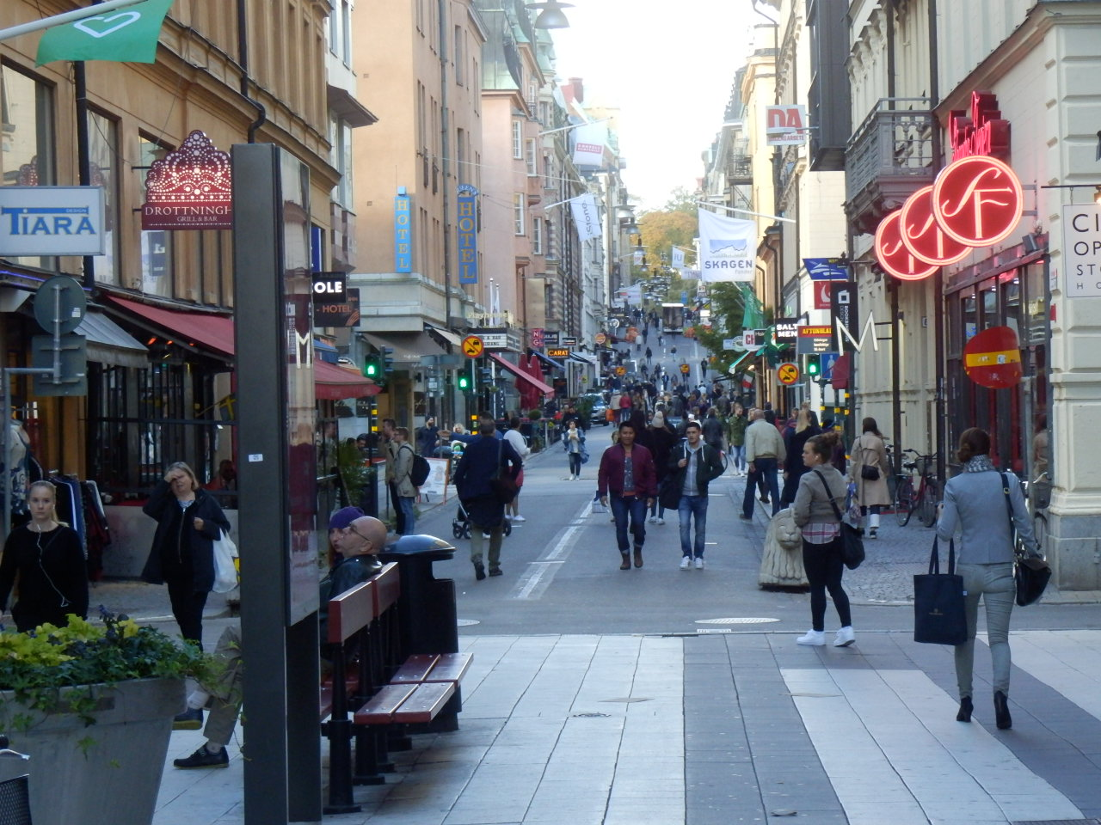
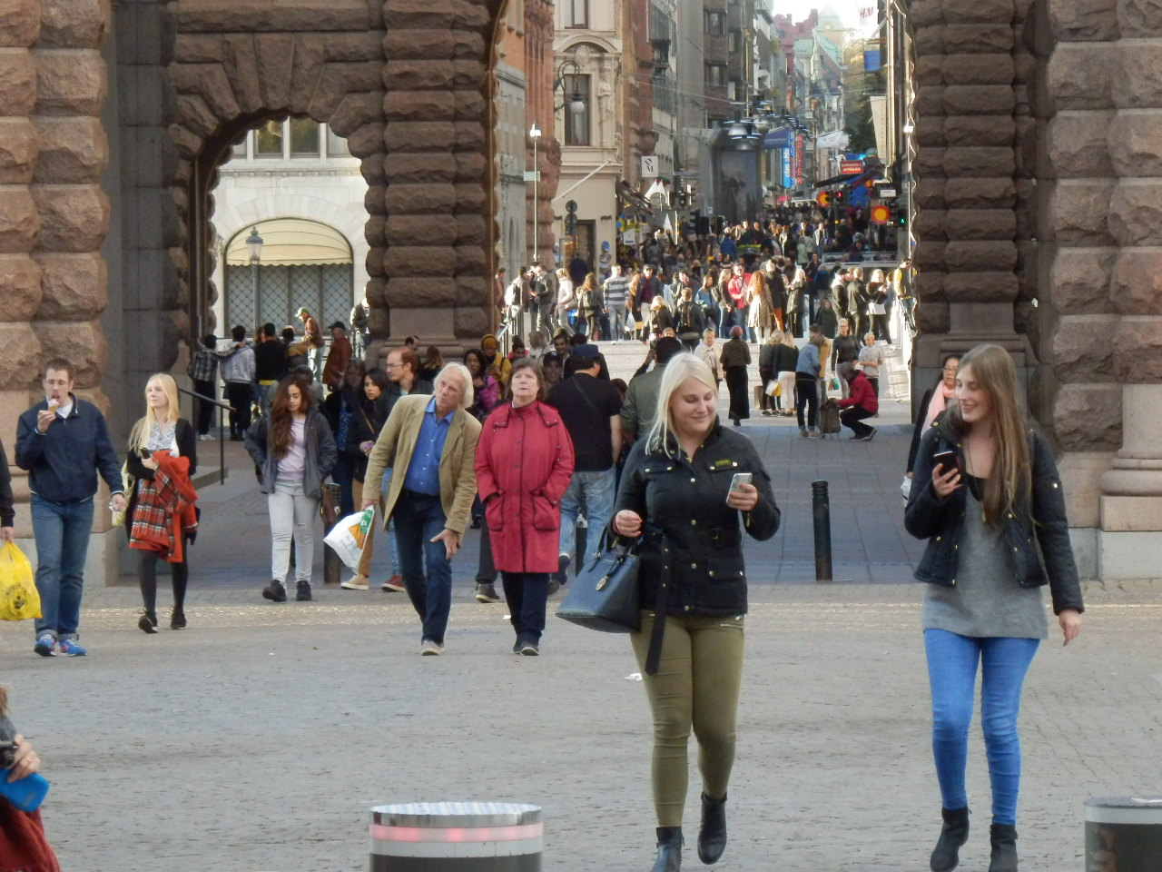
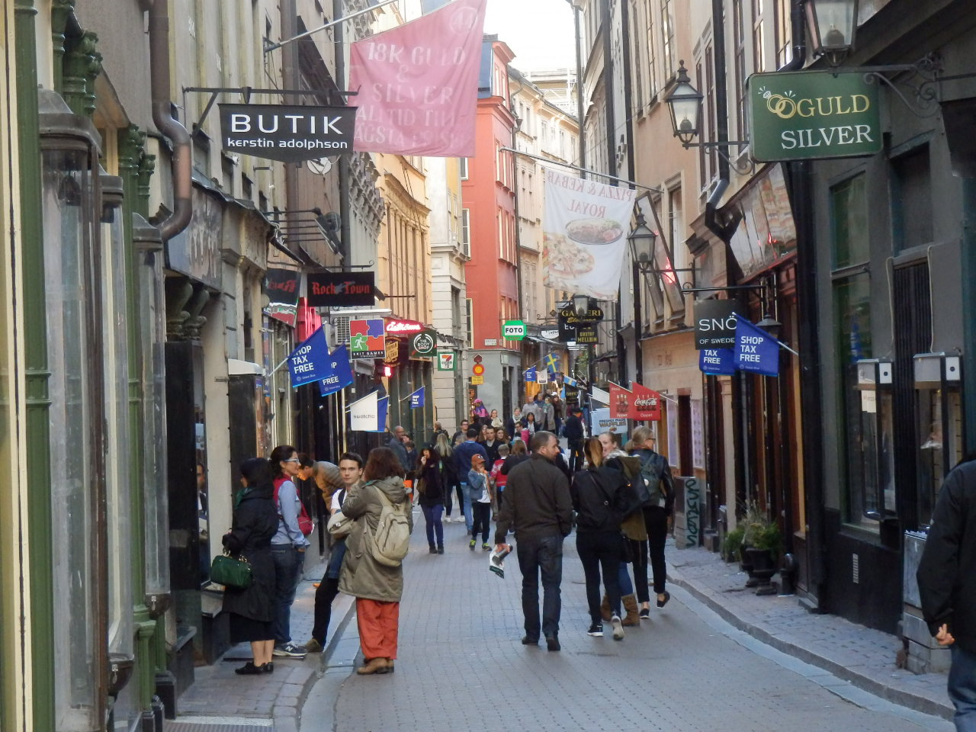
High job centralisation, a focus on public transport. and low to moderate parking in the CBDs (next) encourages rather walkable urban fabrics.

Slide 9
Sweden’s largest five cities are 21% higher in GDP per capita than the five smaller cities. However, the average GDP per capita in 2015 ($33,197 – 1995 US dollars) of these ten Swedish cities is significantly below the 2005 GDP per capita of European cities ($38,683), which would have grown. They were in 2015, however, some 29% more wealthy than Freiburg in Germany, the benchmark small city used here. Stockholm and Göteborg stand out as the wealthiest Swedish cities.

Slide 10
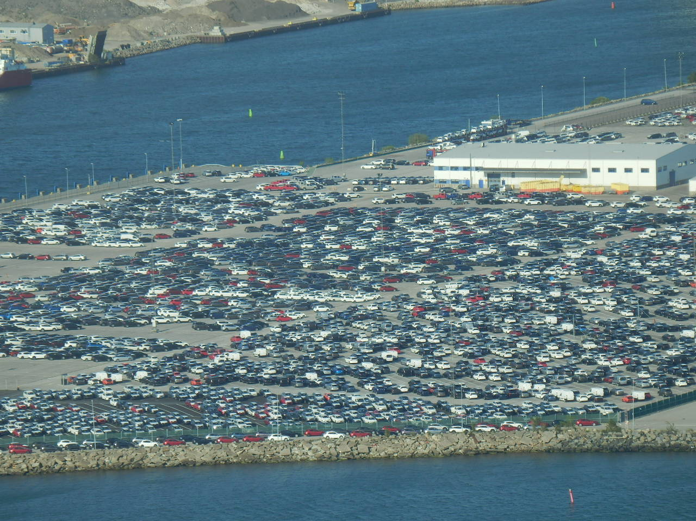
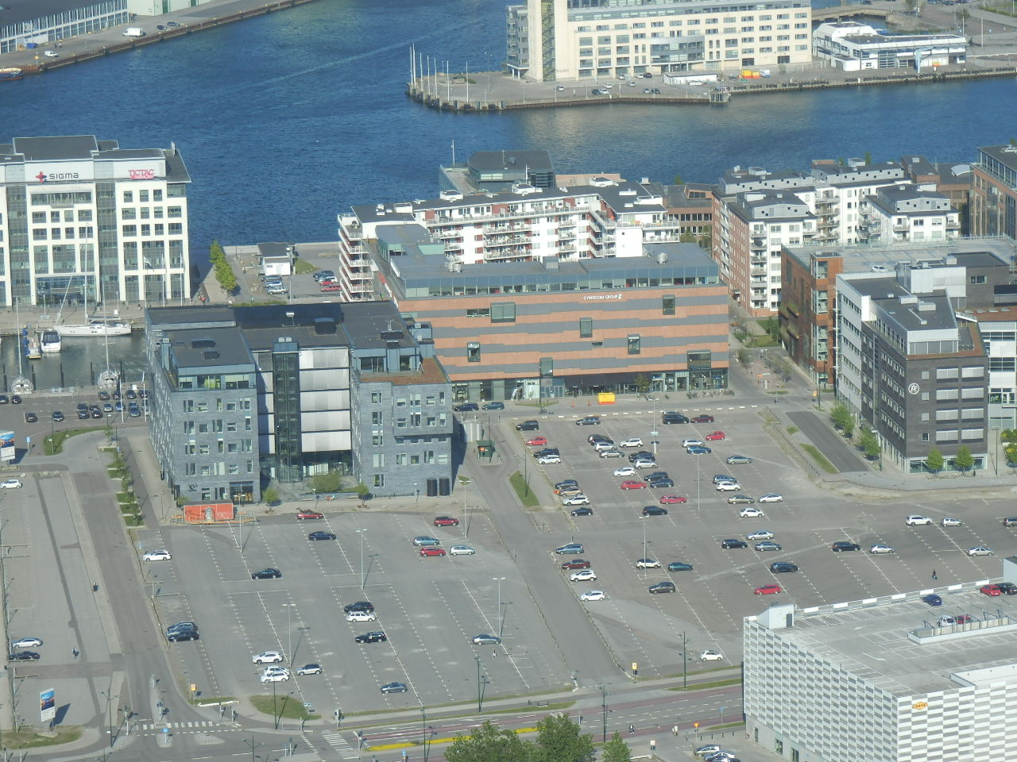
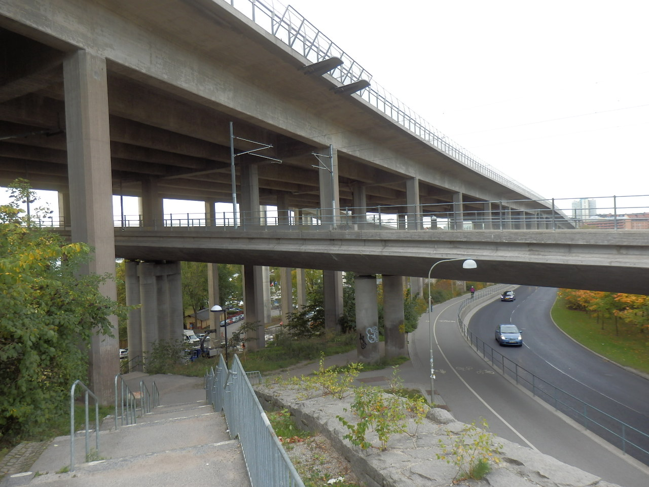
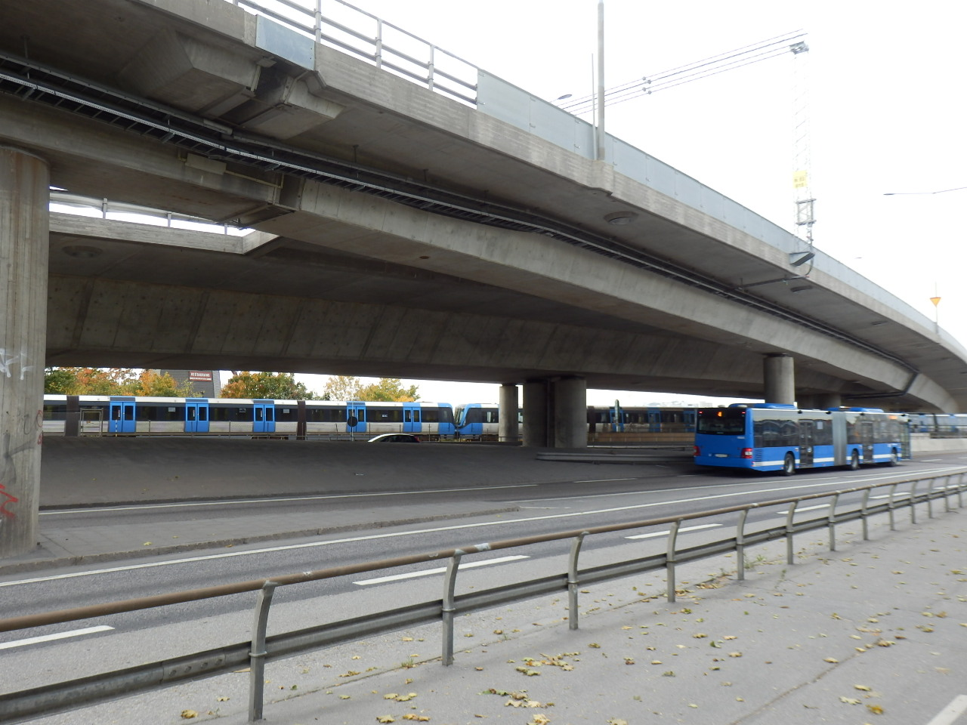
Some parts of Swedish cities given an impression of considerable car orientation, but hard data tells a more nuanced story and urban car orientation in Sweden is often offset with good public transport features and some relatively good non-motorised performance.

Slide 11
Car ownership in Swedish cities is rather similar (smaller cities are 4% higher than the large cities) with a range of 387 (Uppsala) to 481 (Jönköping). The Swedish average is almost 10% higher than in Freiburg, but some 7% below that of other European cities in 2005, which would have grown by 2015.

Slide 12
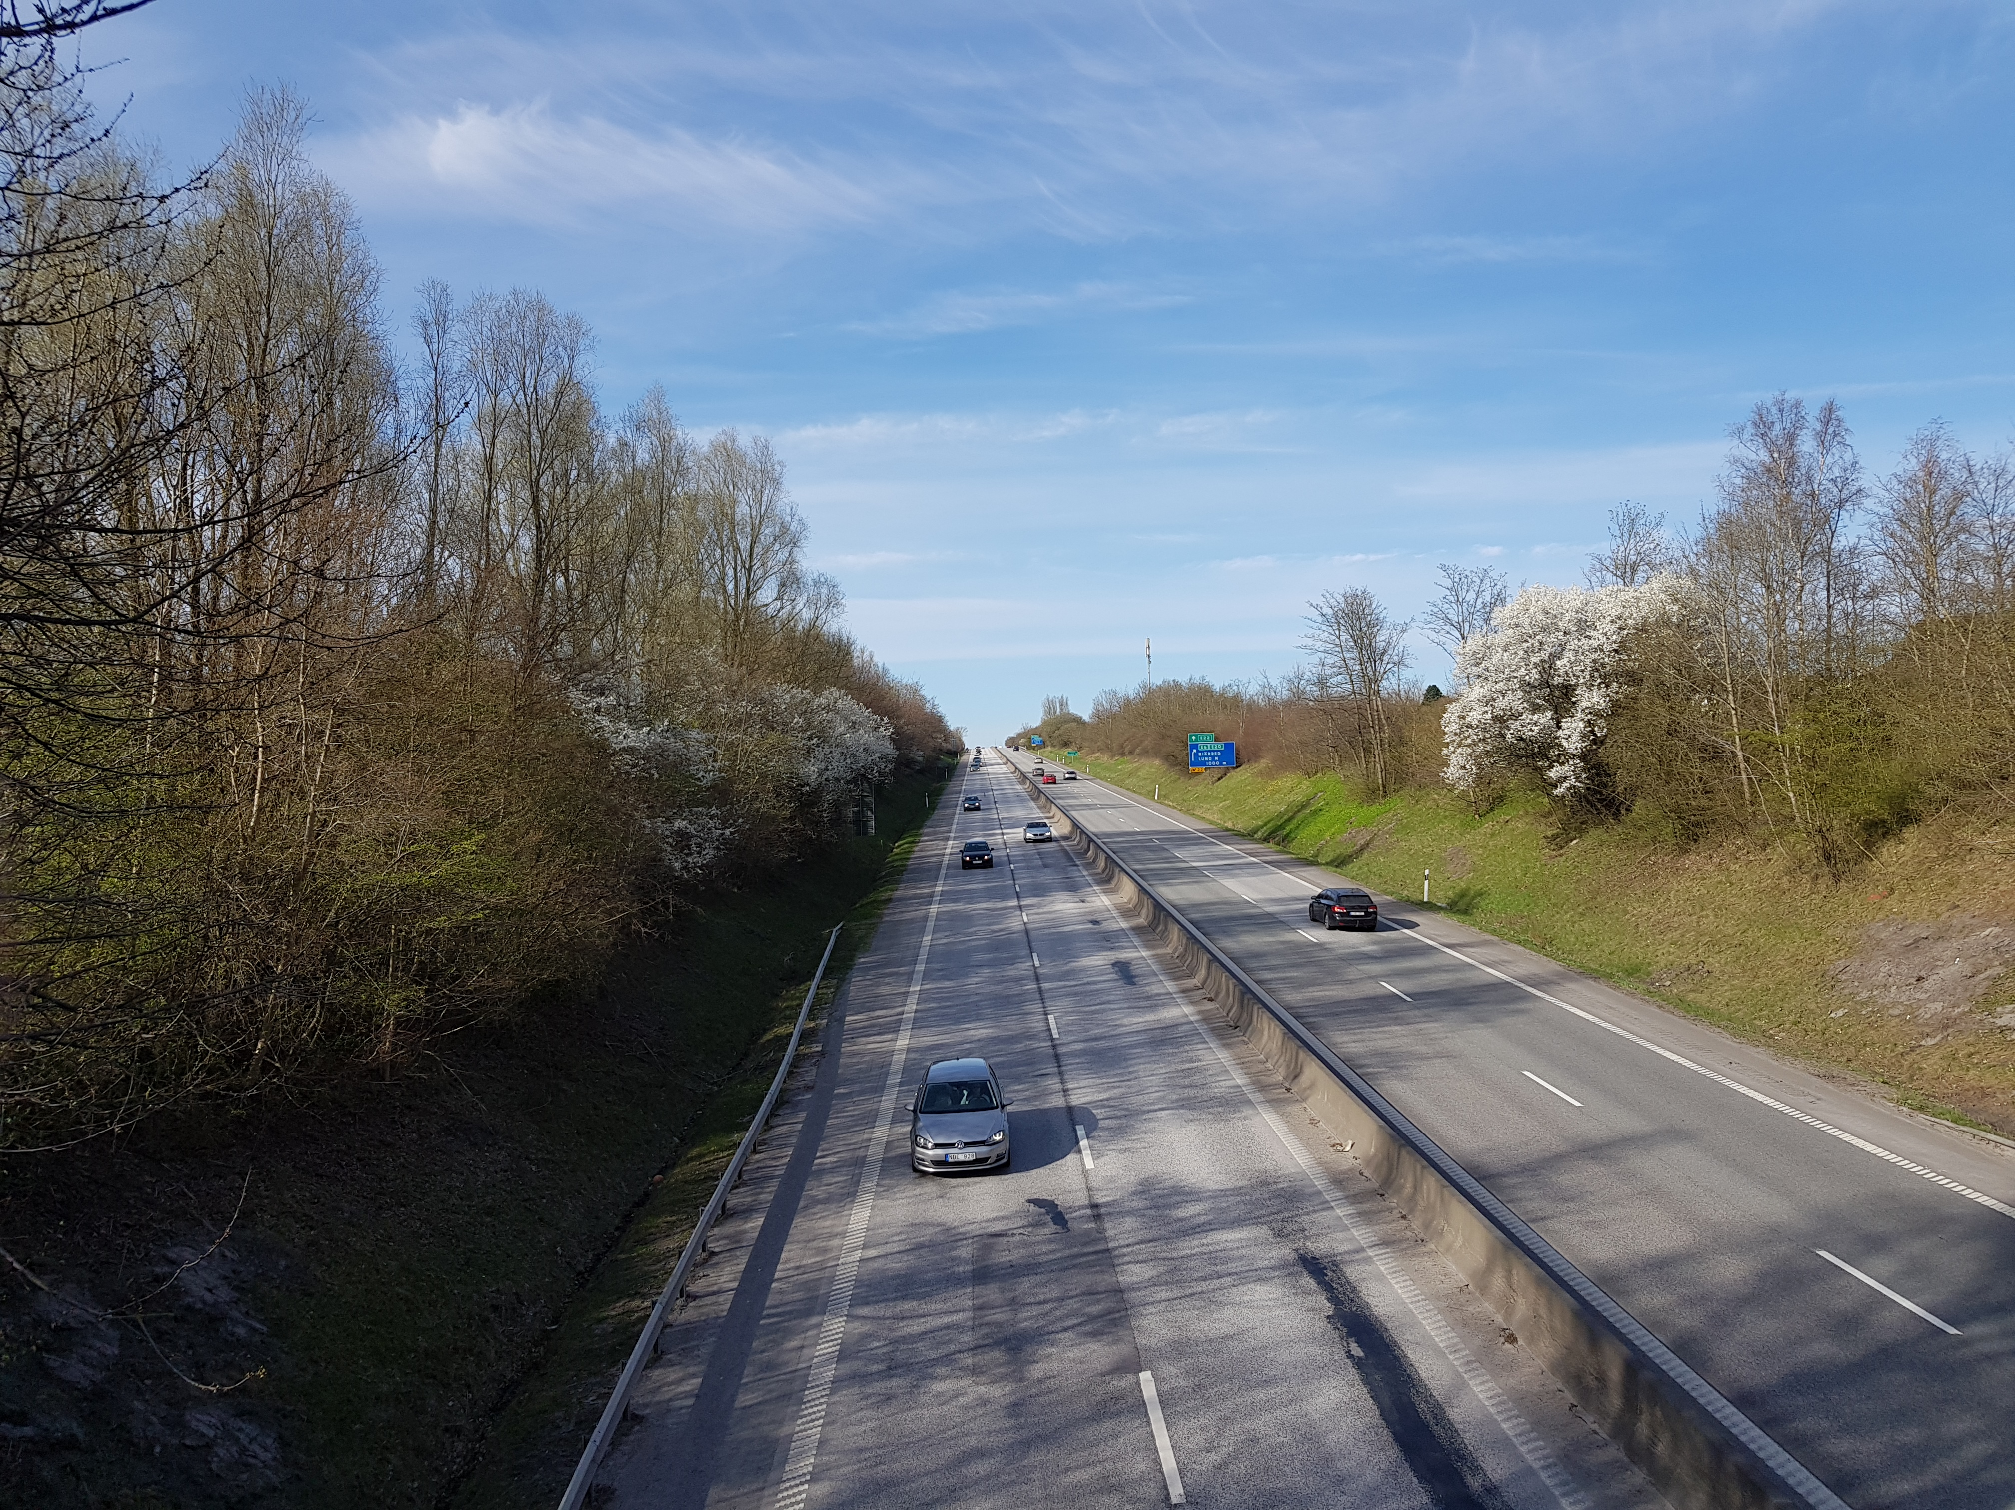
But sometimes impressions of car orientation in Sweden can be correct, as is the case with freeway availability.

Slide 13
Swedish cities are generously endowed with freeways, some 55% higher length per person than in US cities. The smaller cities are even higher than the larger cities. On average, Swedish cities have almost 4 times more freeway length per capita than in Freiburg and this cannot all be accounted for by their lower density than in Freiburg (Freiburg is 2.3 times as dense).

Slide 14
Car passenger kilometres per capita in Swedish cities in 2015 are quite moderate, despite low urban densities and lots of freeway. As a result, energy use in private transport is also comparatively low.
Smaller cities have only 4% higher car use than the larger cities, but car use ranges from 6,131 PKT (Uppsala) to 7,902 (Jönköping). On average, Swedish cities are virtually identical to other European cities in car use in 2005 (including car use in Freiburg).

Slide 15
Swedish cities are low to moderate in CBD parking availability and on average are only 16% higher than their European counterparts. But parking is much more limited in the larger cities 246 per 1000 CBD jobs, compared to 332 in the smaller cities (35% more). Freiburg is in the middle with 271. The range is very large (Stockholm 125 per 1000 jobs and Västerås with 501 or similar to US cities).

Slide 16
Although Swedish cities are generally comparatively low in parking in their CBDs, many parts of Swedish cities are very well equipped with parking (e.g. Malmö West Harbour, even if some of this parking will ultimately disappear due to new construction) .

Slide 17
Reserved PT route in Swedish cities is dominated by rail with very low provision of bus lanes. The smaller cities have some 3.6 times more public transport reserved route per capita than the larger cities and overall Swedish cities have some 2.4 times more reserved route per capita than European cities in 2005. The range is massive from 1,878 m/1000 persons in Umeå to 222 in Malmö (8-fold difference).

Slide 18
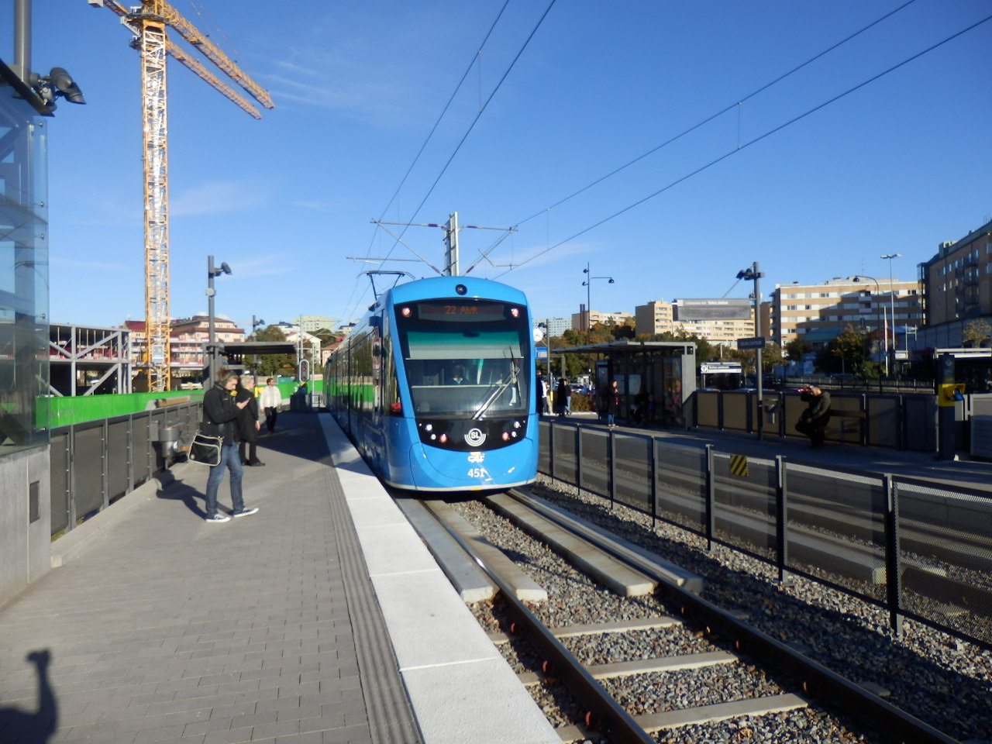
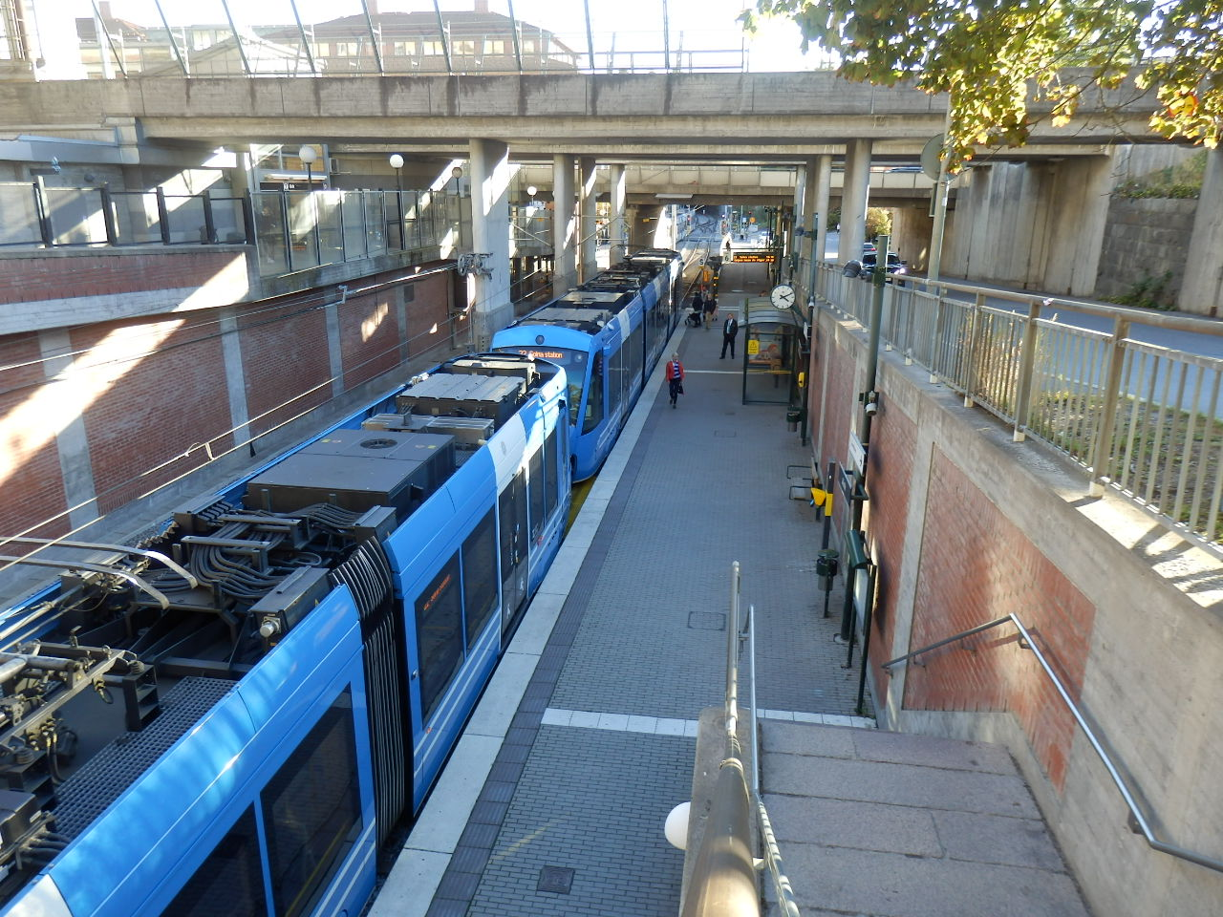
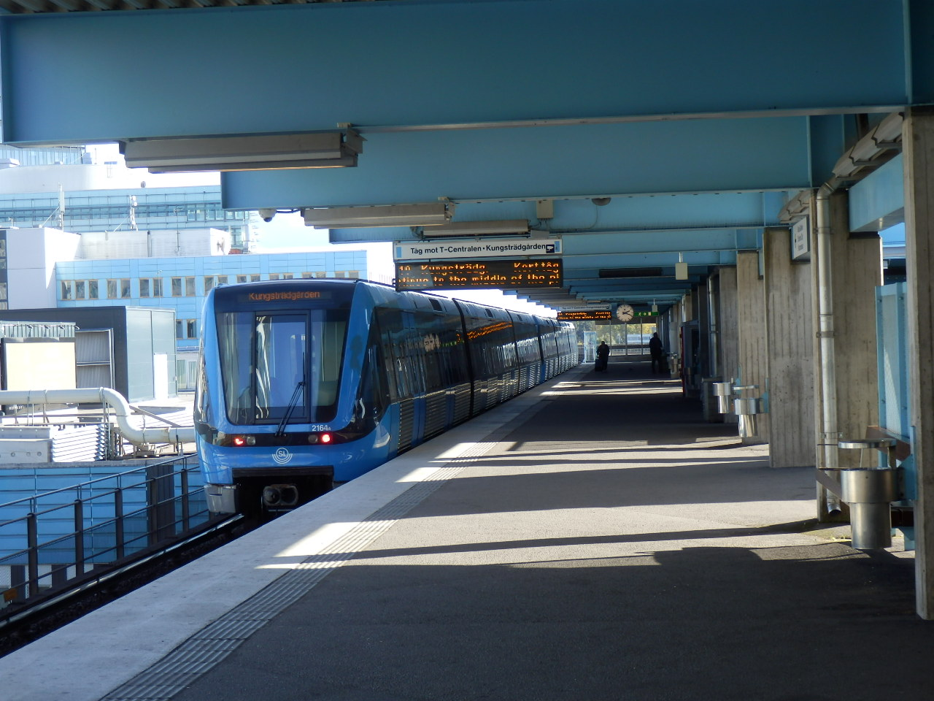
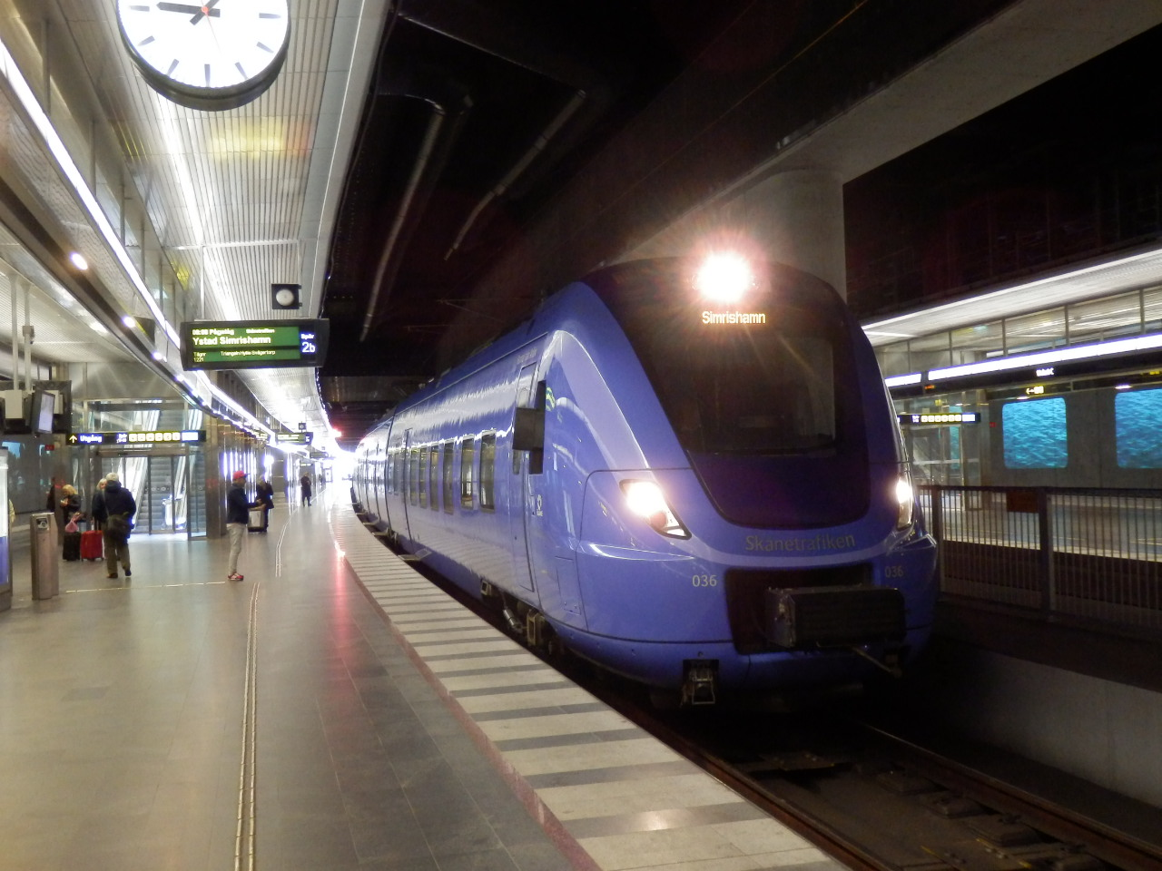
Reserved public transport route, especially rail, is important for competing with the car in speed terms and encouraging public transport use.

Slide 19
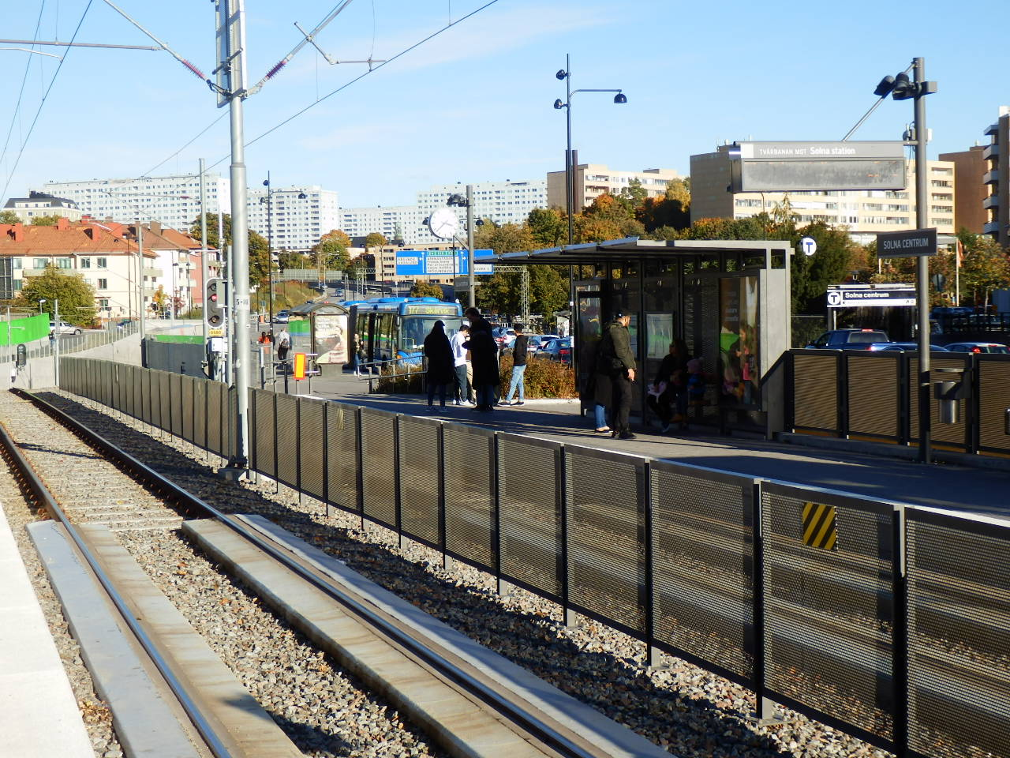
Swedish cities have 41% less PT reserved route compared to freeways than other European cities because their freeway provision is so high. Freiburg has 19.1 times more reserved PT route than freeways, whereas Swedish cities have only 3.3. The small cities have almost a 5 times higher ratio than the larger cities.

Slide 20
Swedish cities have a healthy relationship between overall average speed of public transport compared to cars (0.93 or very similar speeds). Larger cities (0.98) are better in this item due to more rail and slower car speeds than the smaller cities (0.88 speed ratio). But Freiburg’s public transport speed exceeds road traffic speed by a factor of 1.07. There is a big range in Sweden from 1.27 in Linköping to 0.71 in Örebro.

Slide 21
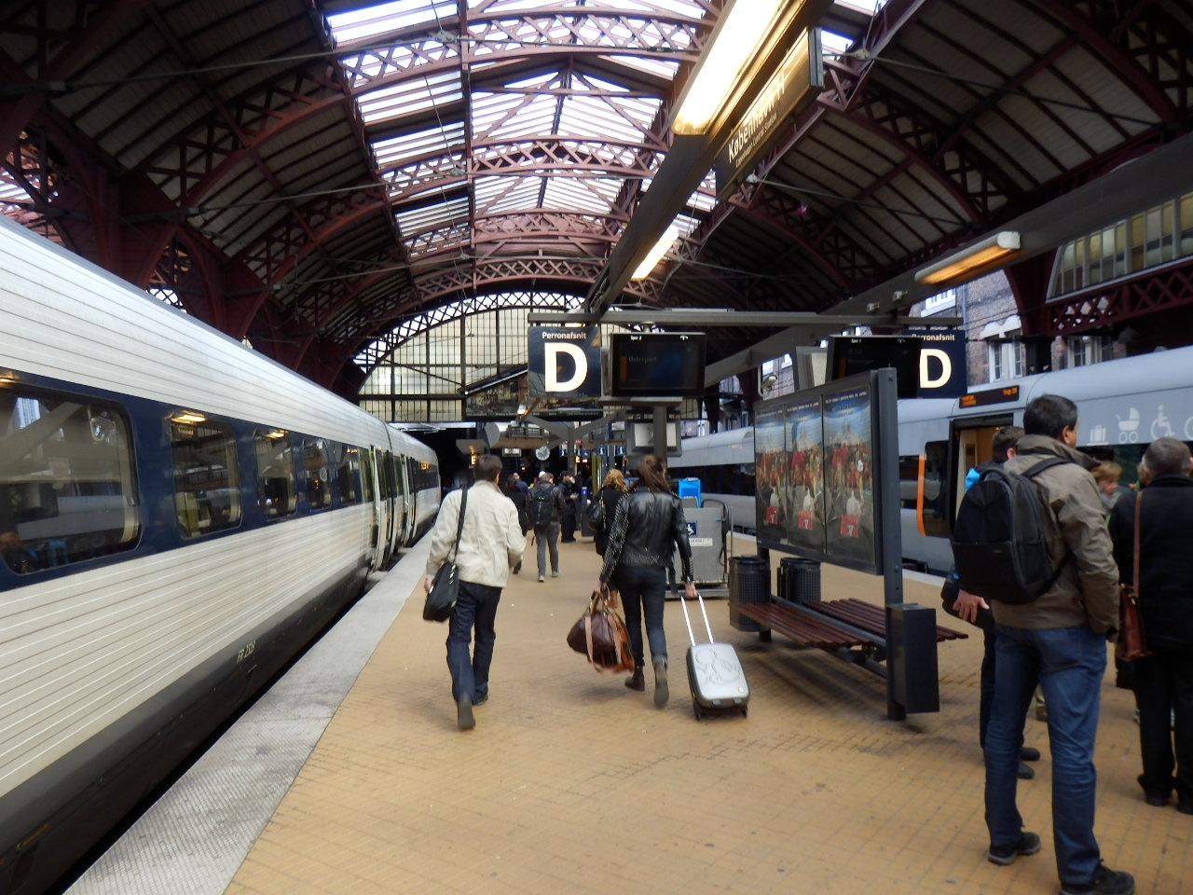
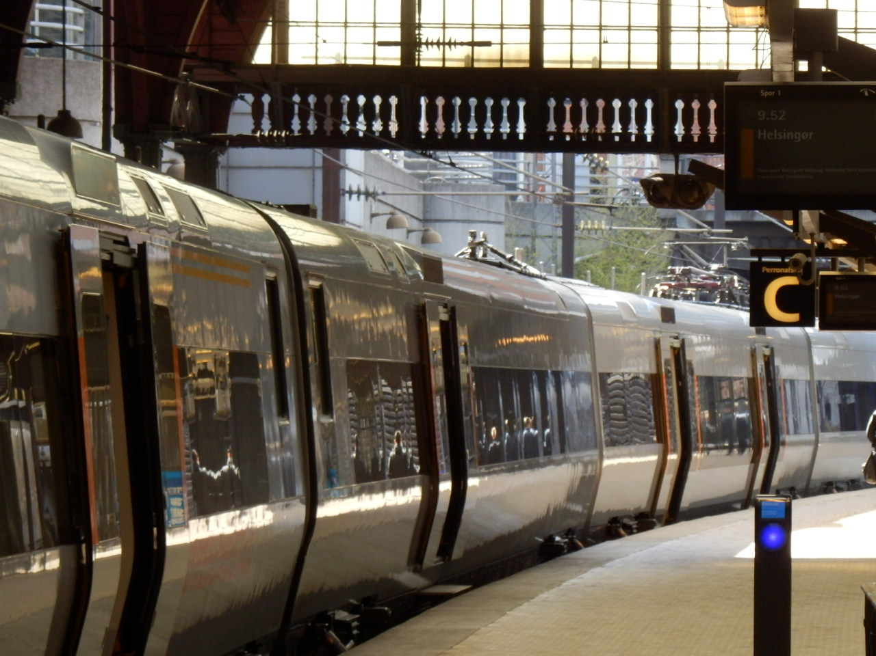
Regional rail in these ten Swedish cities has an overall average speed of 80.5 km/h, which competes very well with cars for many trips (42.6 km/h) and is higher than in virtually all other cities with comparable rail services (probably because stops are fewer, due to low densities).
The smaller Swedish cities’ rail services have an average speed of 89.6 km/h (cars 47.8 km/h) while the larger cities have 71.5 km/h (cars 37.3 km/h).

Slide 22
Swedish cities have overall very healthy levels of PT service in terms of seat kilometres offered. On average they are a bit less than European cities as a whole (7% less), but much higher than in Freiburg. However, the larger Swedish cities exceed the European levels (13% more) while the smaller ones are 26% lower than the European cites.

Slide 23
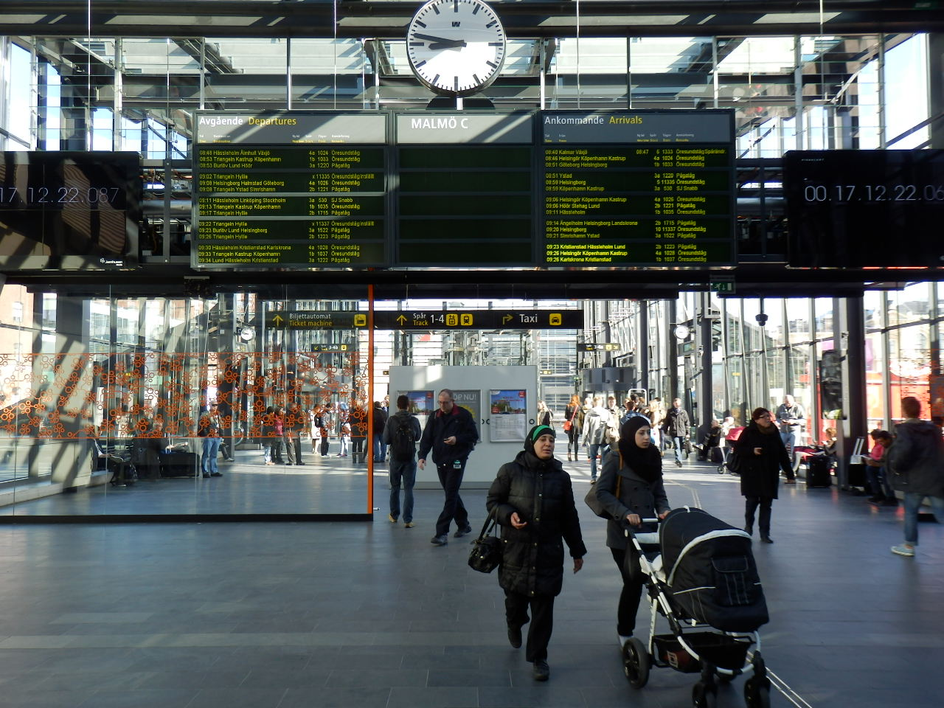
Use of public transport in Swedish cities is mediocre in boardings per capita (1/3 of the European average). In this factor there is a stark difference between the larger Swedish cities (195 per capita) and the smaller cities (61 per capita), which is less than the US level. Freiburg on the other hand is almost the same as the larger Swedish cities (192 per capita). Four of the five small cities are below the US average.

Slide 24
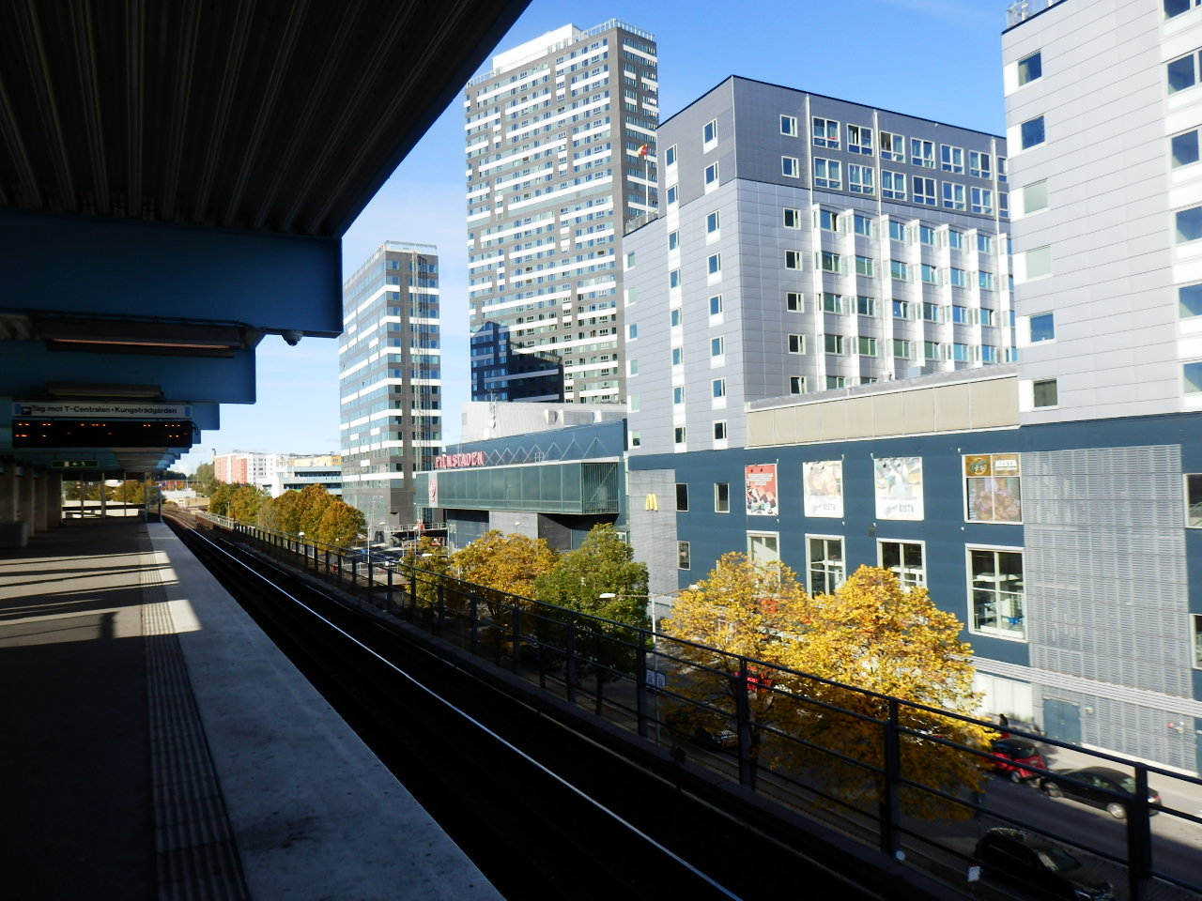
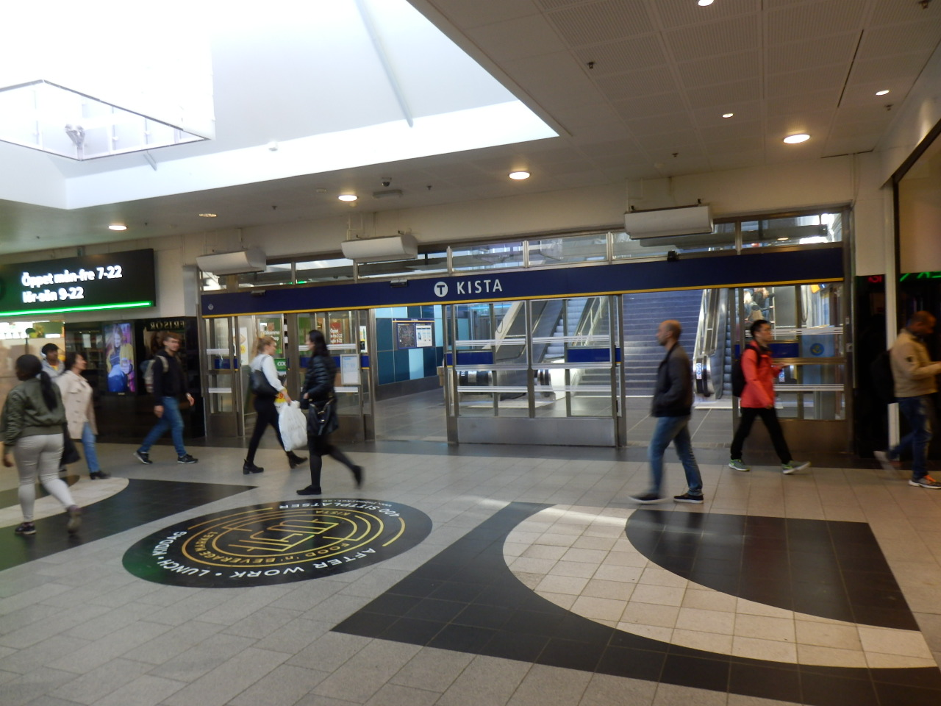
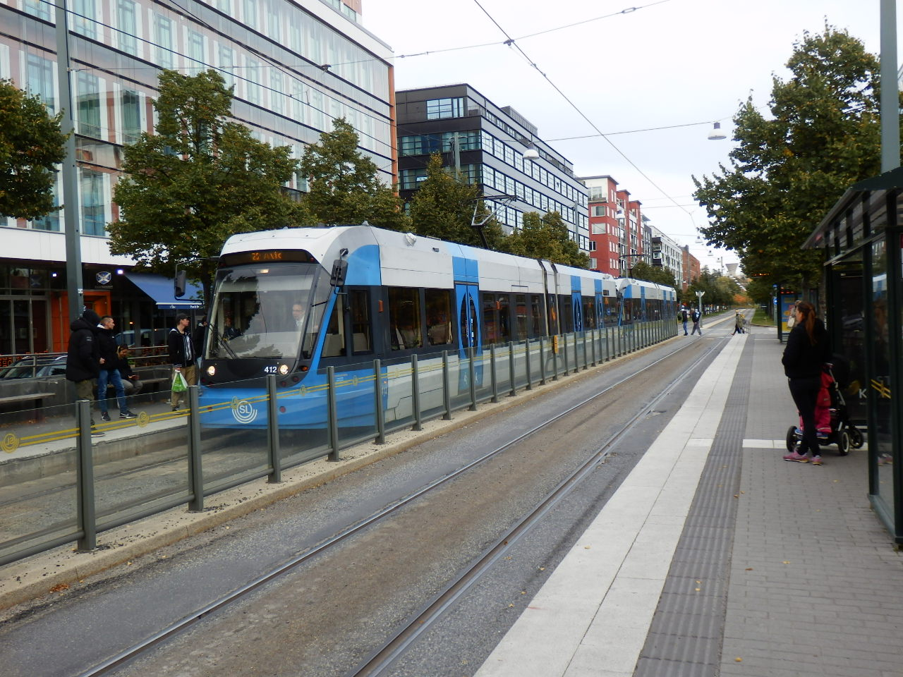
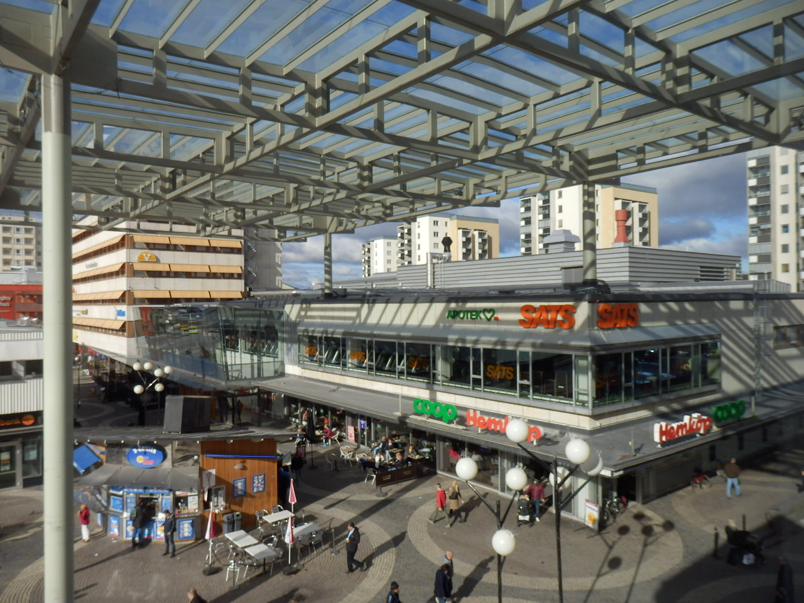
Stockholm has the highest boardings per capita of all Swedish cities (359 per capita) due to its strong rail orientation and land use integration. This needs to be a priority in other Swedish cities. Örebro has a tiny 39 boardings per capita and is amongst the worst of the US cities!

Slide 25
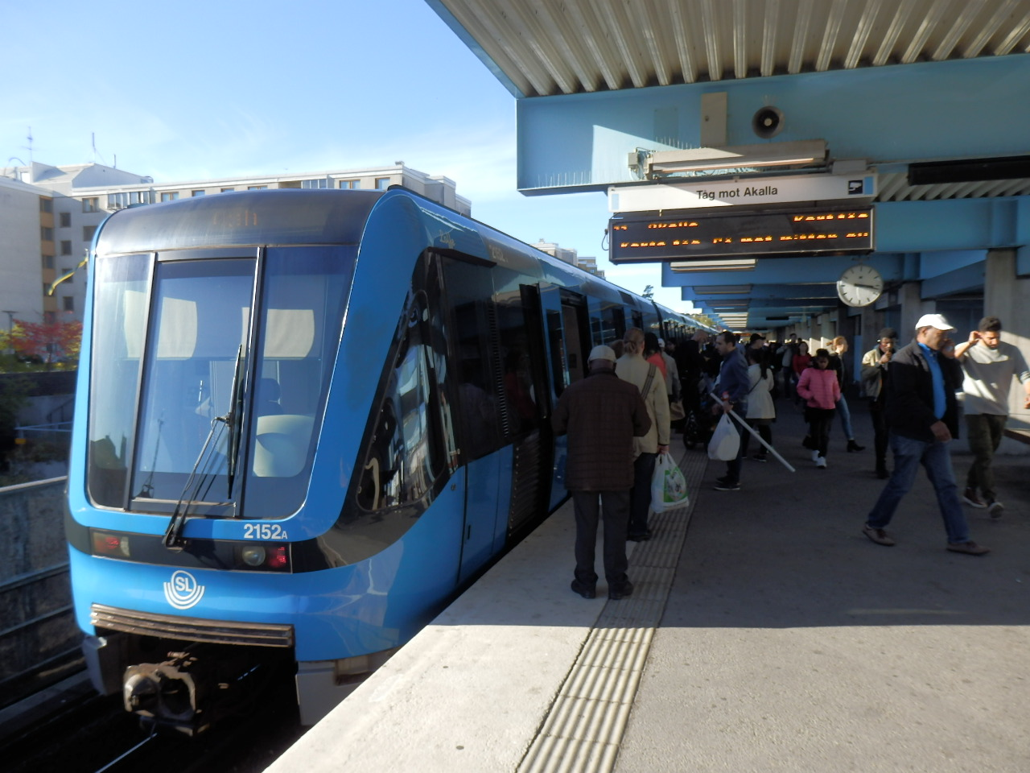
Use of rail (boardings) in Swedish cities is very low (44 boardings per capita) compared to Europe (240 per capita). The larger cities have 80 but the smaller Swedish cities have 9 rail boardings per capita, way below even the US at 28. Freiburg, the small city benchmark here has 144 rail boardings per capita!

Slide 26
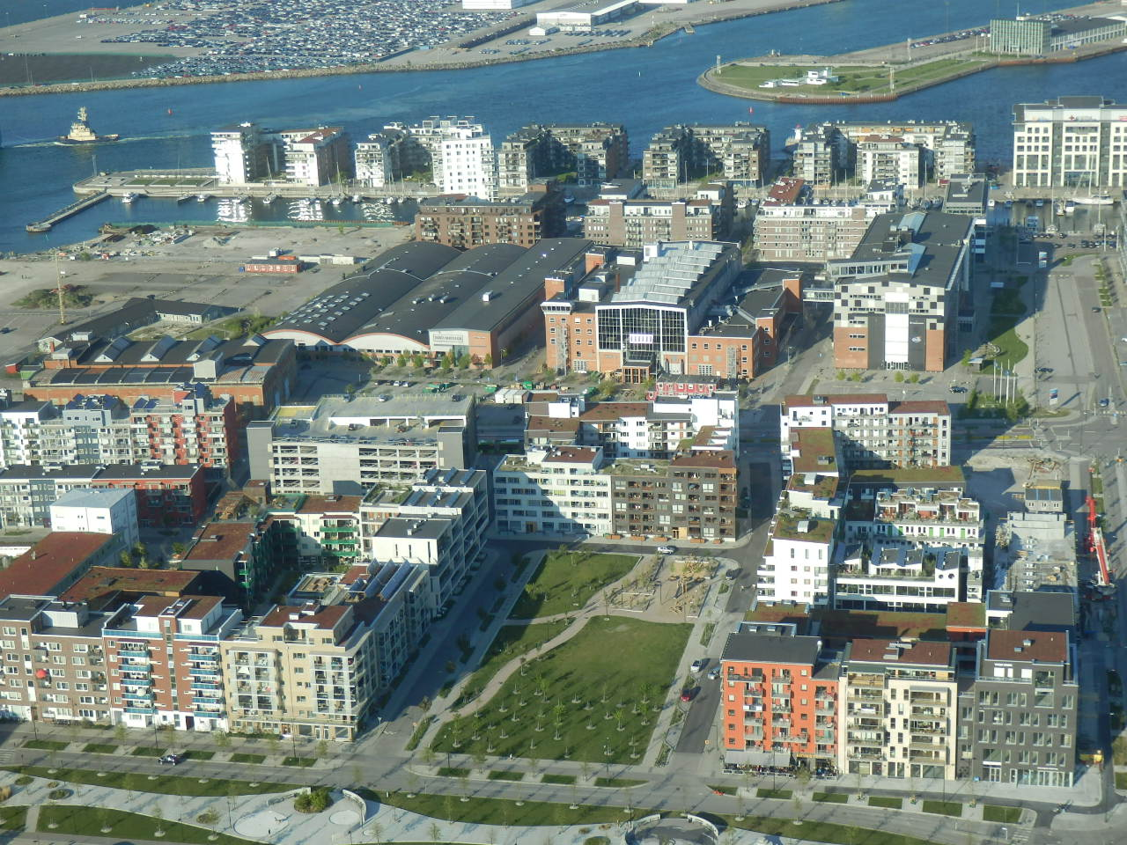
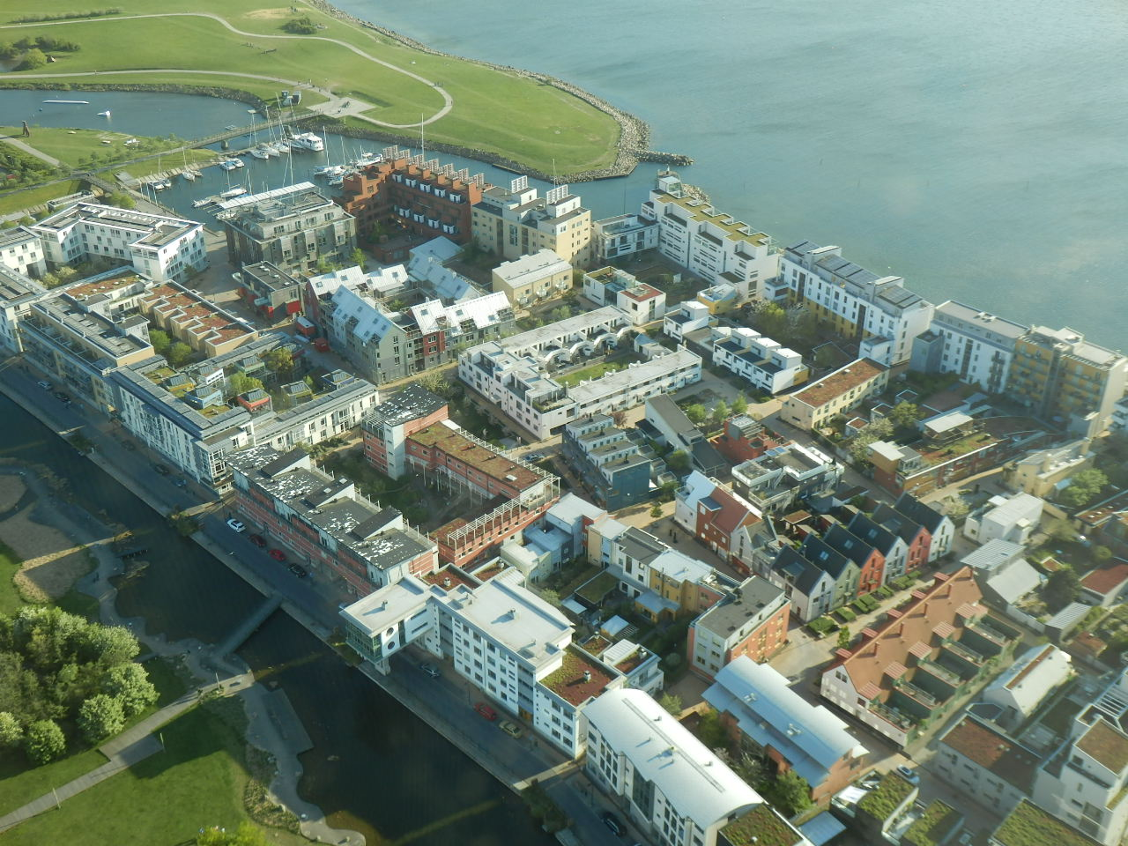
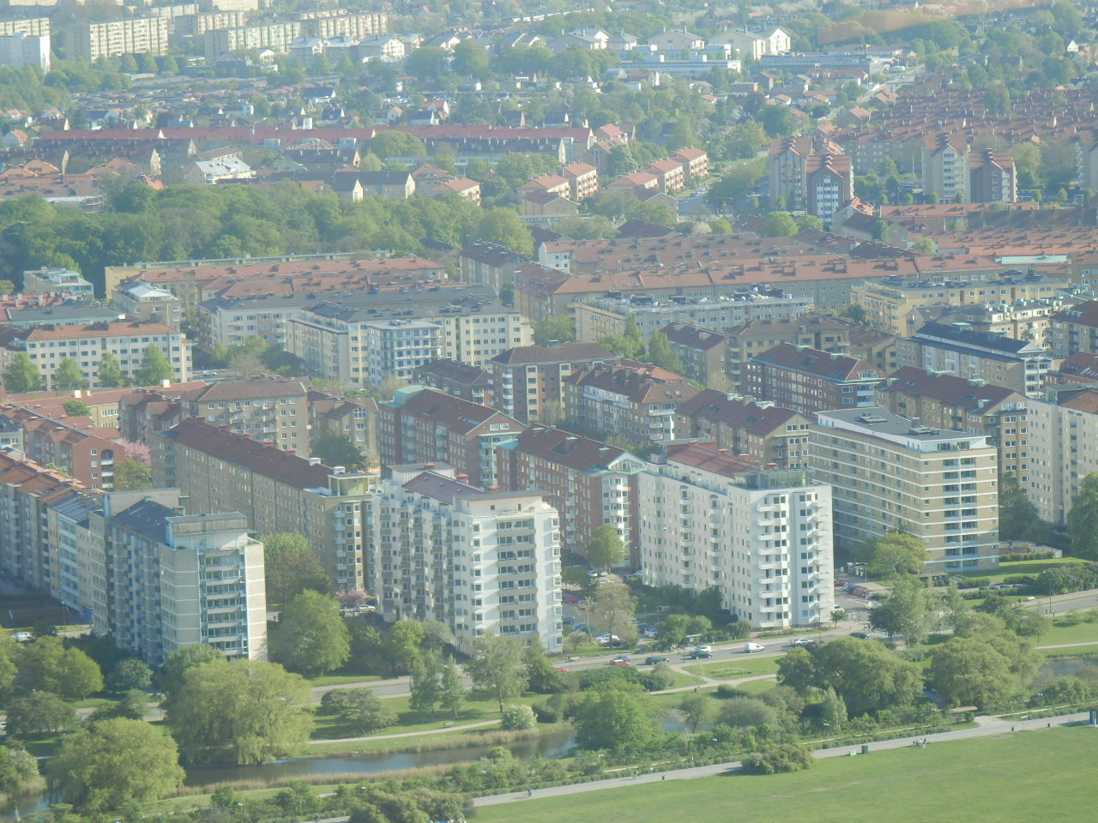
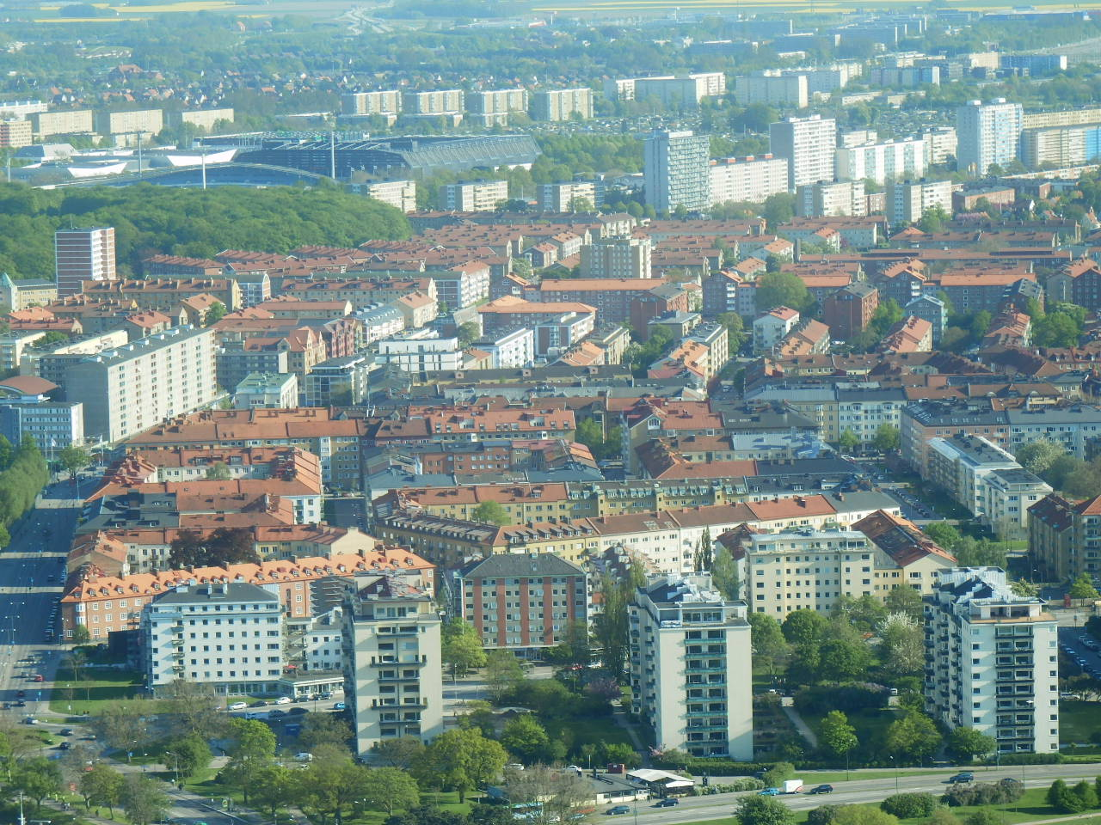
Many parts of Swedish cities have dense urbanism, but not all are connected to competitive rail services - for example, the West Harbour and other older parts of Malmö.

Slide 27
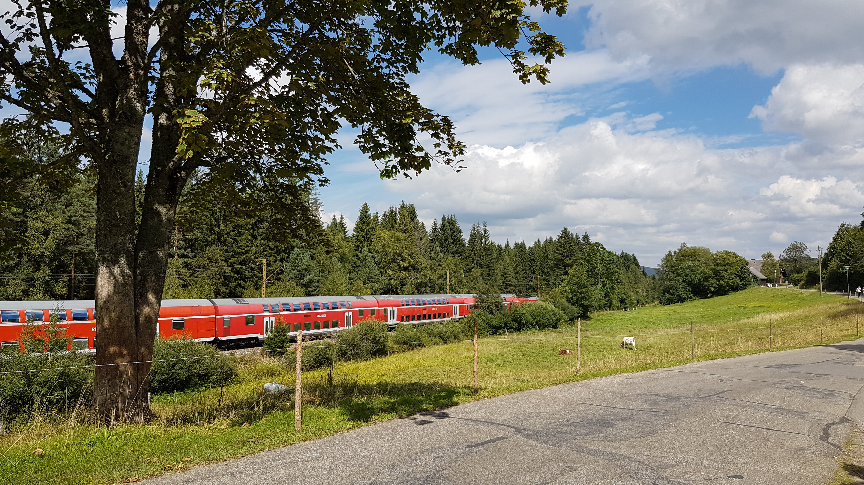
PT use in passenger km (PKT) is more competitive in Swedish cities due to the long trip distances especially by rail, but still nowhere near average European levels (38% lower). But in PKT, Swedish cities are 2.4 times higher than US cities. Larger Swedish cities are much better, while the small Swedish cities have only a bit over 50% of the PKT per capita by public transport of the larger Swedish cities.

Slide 28
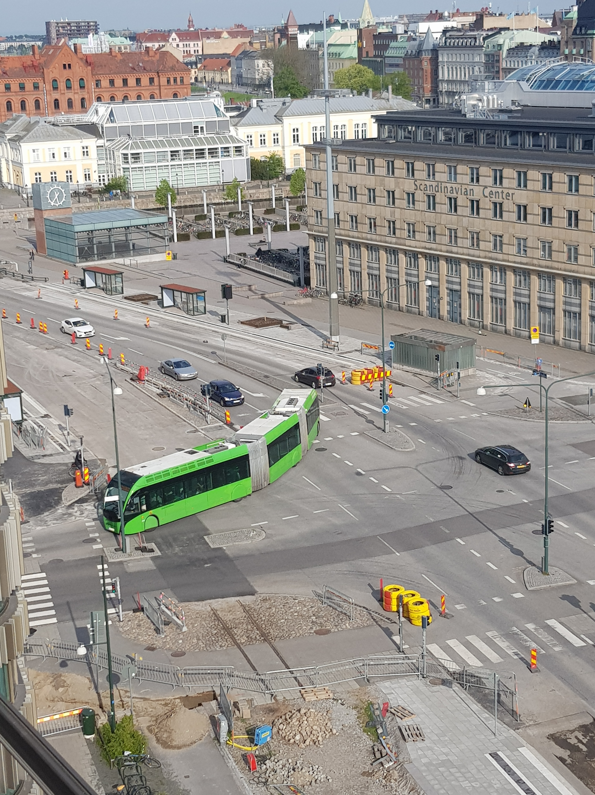
As a percentage of all daily trips, Swedish cities overall are over 2.5 times better in public transport than US cities, while the larger ones are over 3.5 times better. The smaller cities do badly at only 9.3% compared to 19.4% in the larger cities. Likewise, Freiburg achieves only 16.0%. Stockholm at 31.6% is the best Swedish city, while Västerås at 6.7% is the worst.

Slide 29
What do cities collect per passenger km from the farebox? Mostly this factor ranges between about 8 and 10 US cents (US$1995) per PKT, with all the averages for Swedish cities sitting right in the middle at 9 cents per PKT and Freiburg at 8 cents. Örebro strangely raises 17 cents per PKT and Västerås only 6 cents, so there is some significant variation in Sweden.

Slide 30
Operating costs per PKT are less consistent, but the averages for small, larger and all Swedish cities are similar (23 to 26 cents per PKT) and are mostly in line with operating costs in all other parts of the world. Freiburg’s costs are significantly lower. Örebro again stands out with very high costs per PKT (48 cents per PKT) and Umeå is low (17 cents).

Slide 31
Cost recovery from the farebox has a massive range across the world with Swedish cities averaging 43% (46% in the larger cities and 40% in the smaller cities). This is significantly below the European average in 2005 of 60%, though Stockholm recovers 64%. The lowest recovery is Helsingborg 33% or very close to the US level of 31%.

Slide 32
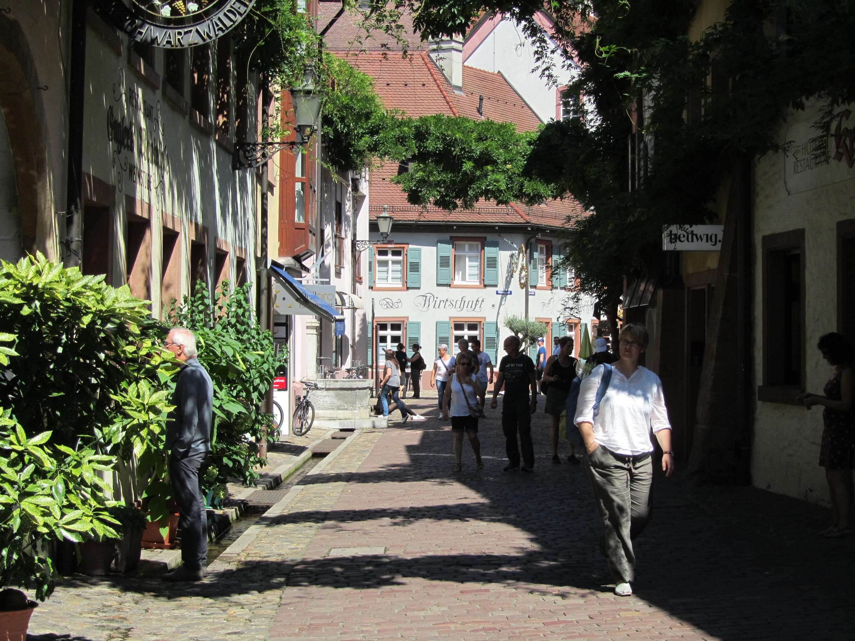
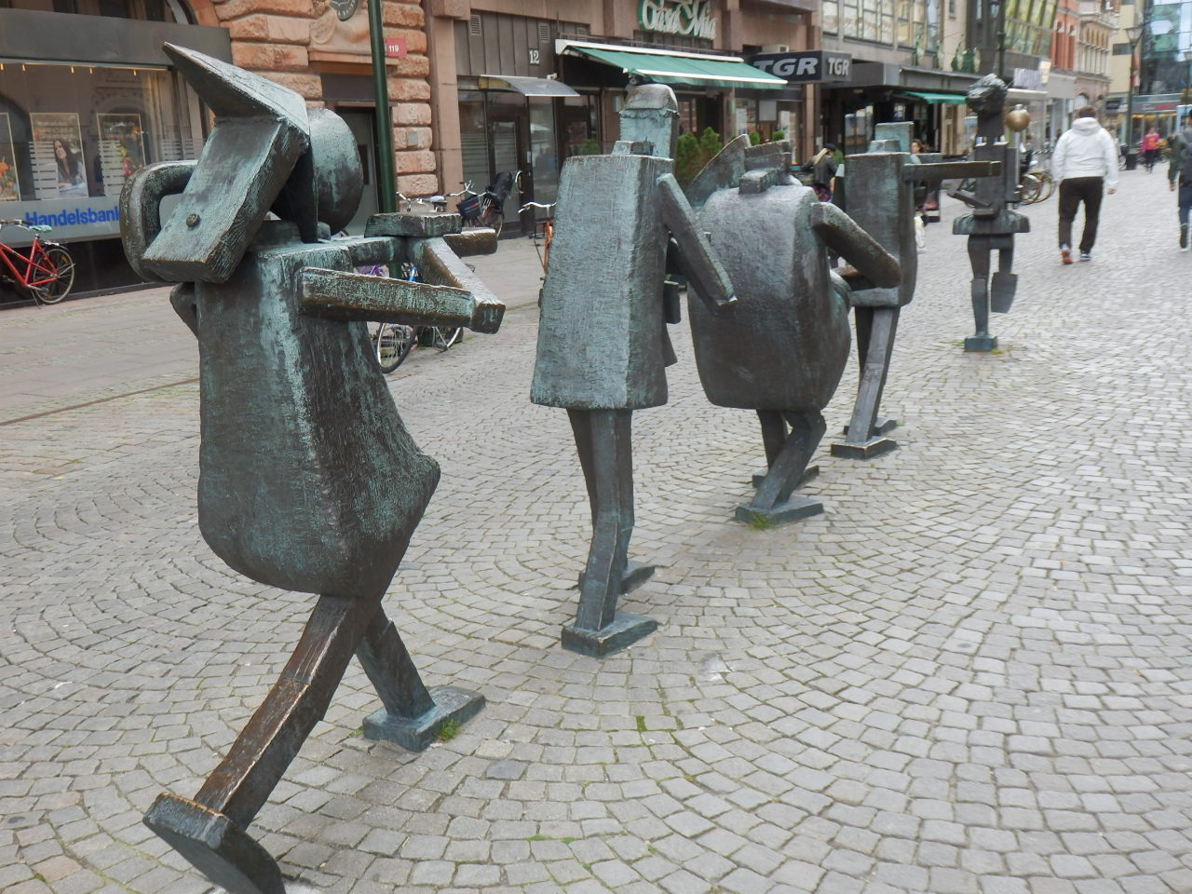
Swedish cities clearly distinguish themselves from US cities in walking and cycling, having 30.0% of their daily trips by NMM or over three times more. The smaller cities are 32.8% and the larger are 27.1%. Freiburg, however, is a walking and cycling capital with 63% of daily trips! The density factor is clearly at work here. Jönköping is the worst of the Swedish cities with 21.2% while Uppsala is the best with 46.8%!
Freiburg
Malmö

Slide 33
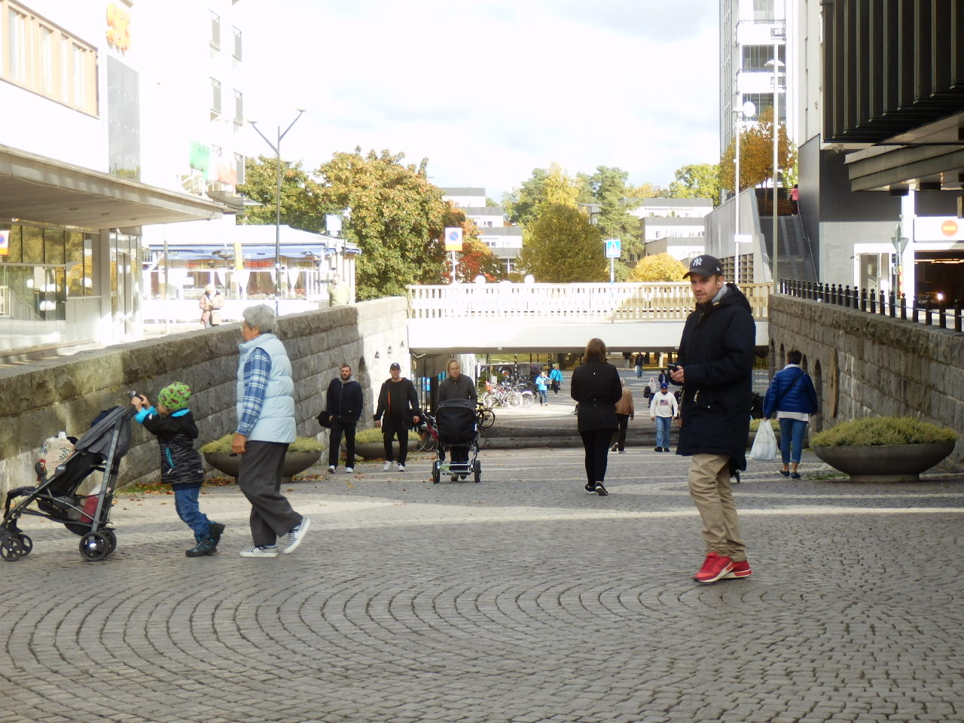
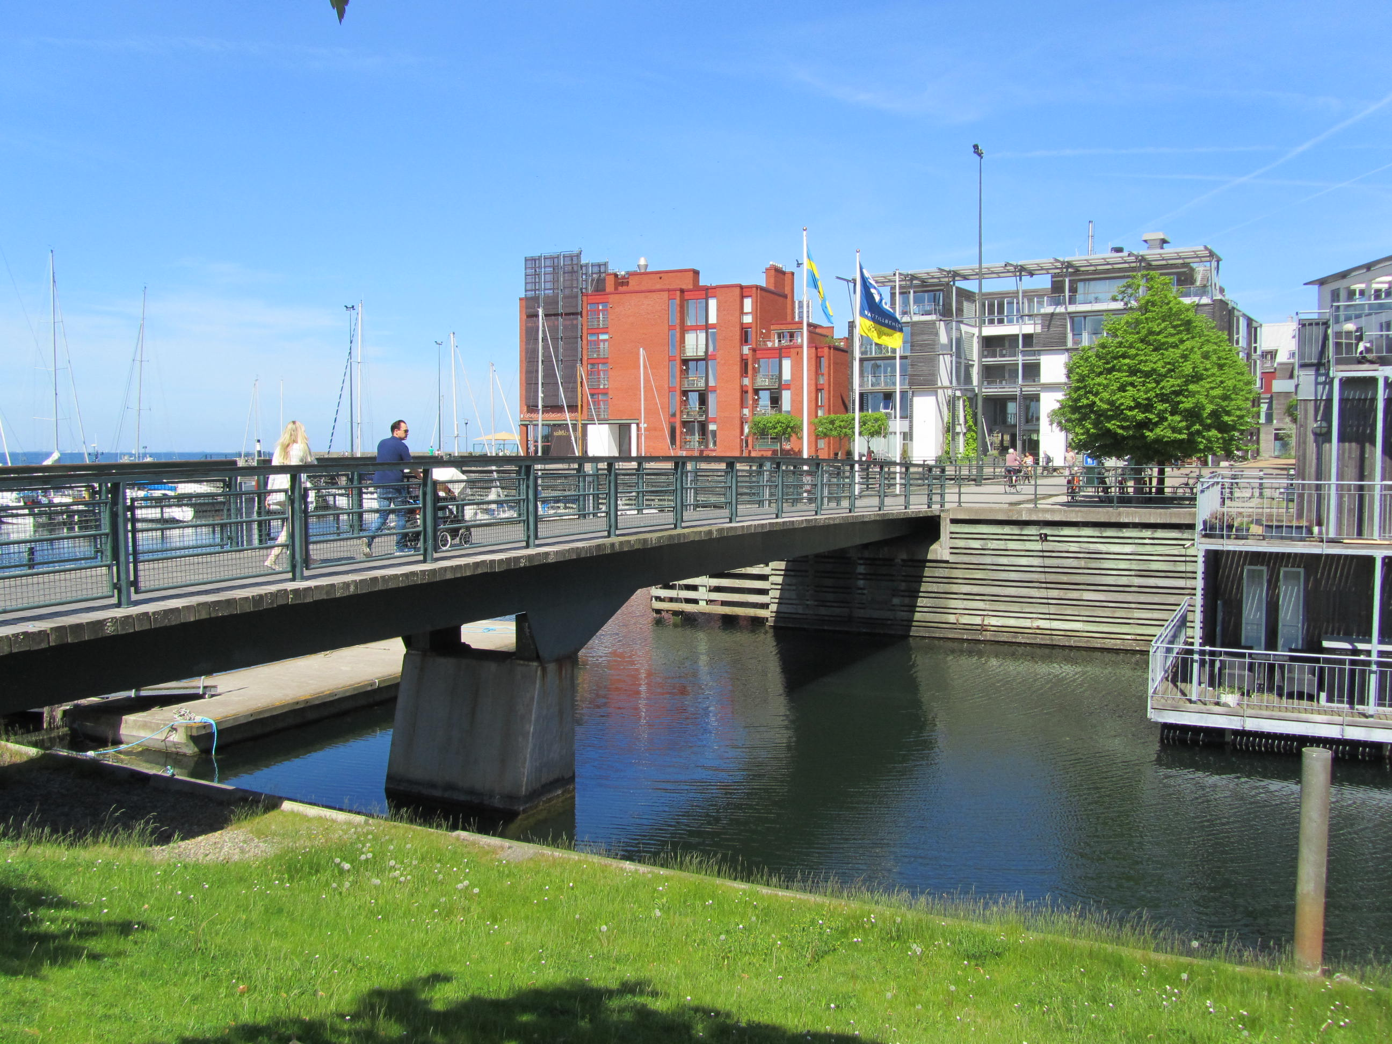
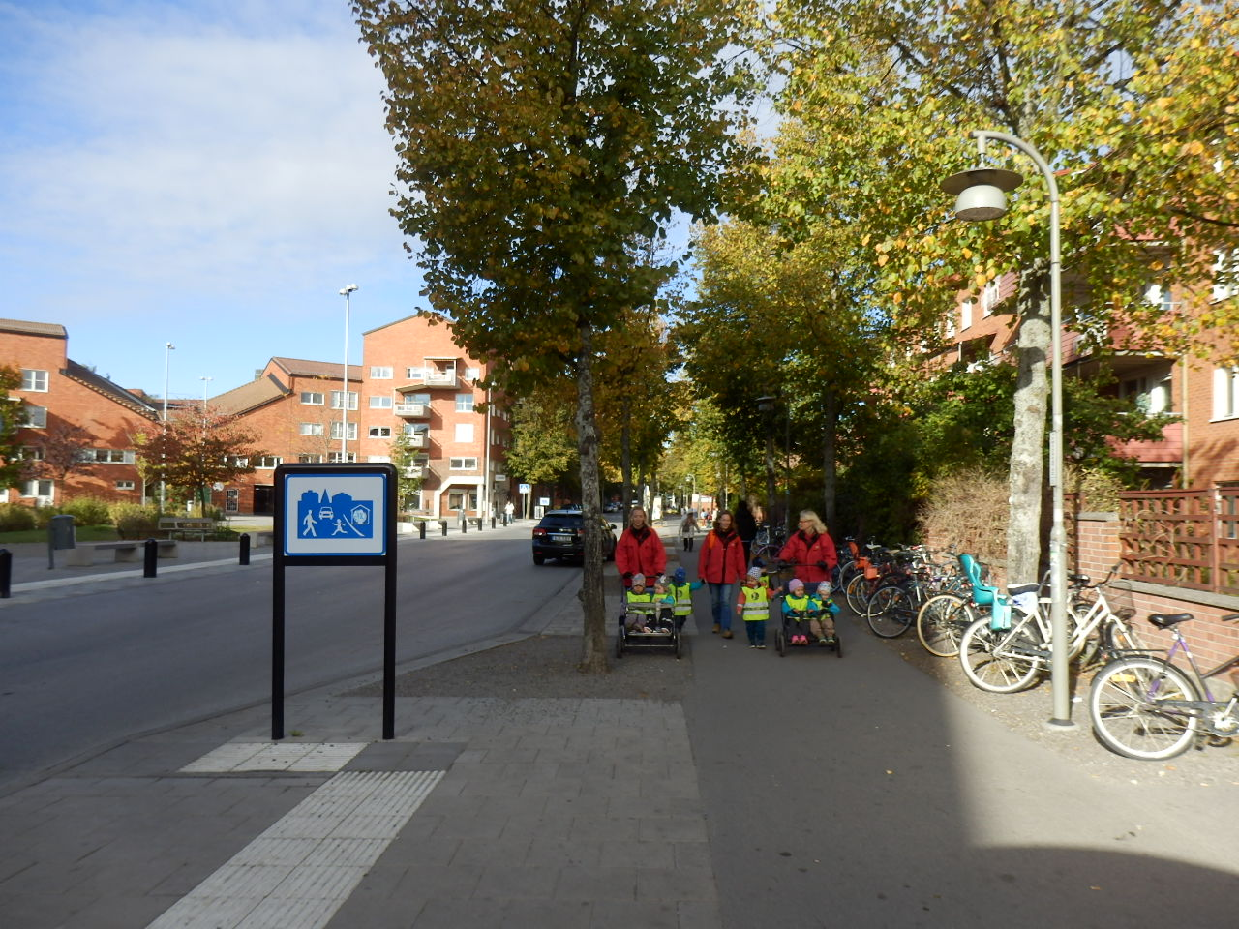
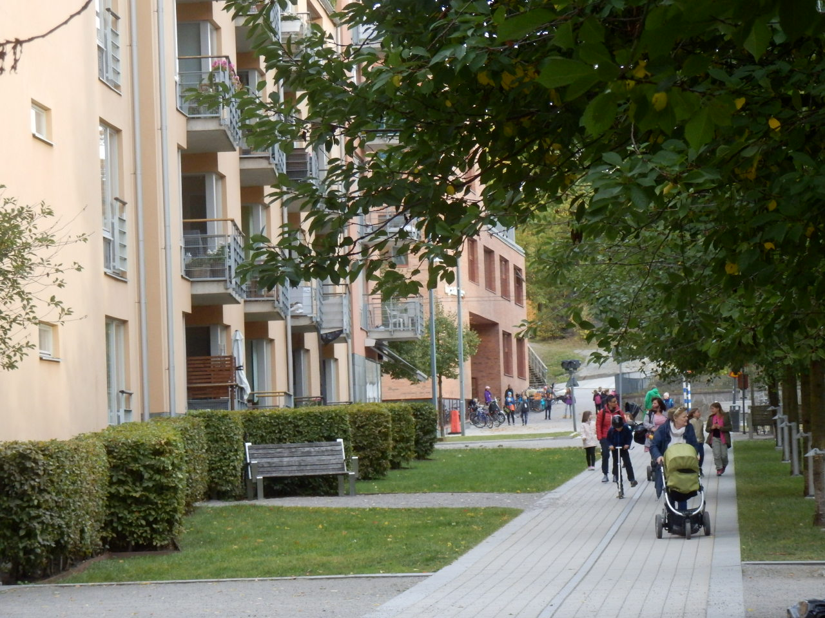
Many Swedish cities have very good provision and performance on walking and cycling, but this seems to be primarily focussed in areas of higher urban densities and mixed land uses where trip making by foot and bike is high.

Slide 34
Swedish cities lead the world in having amongst the lowest total transport emissions per capita averaging 17 kg per capita (US 185 kg). Jönköping is highest with 26 kg and Uppsala lowest with 9 kg! Freiburg is also low (24 kg). Other cities will have reduced since 2005 but almost certainly not to Swedish levels.

Slide 35
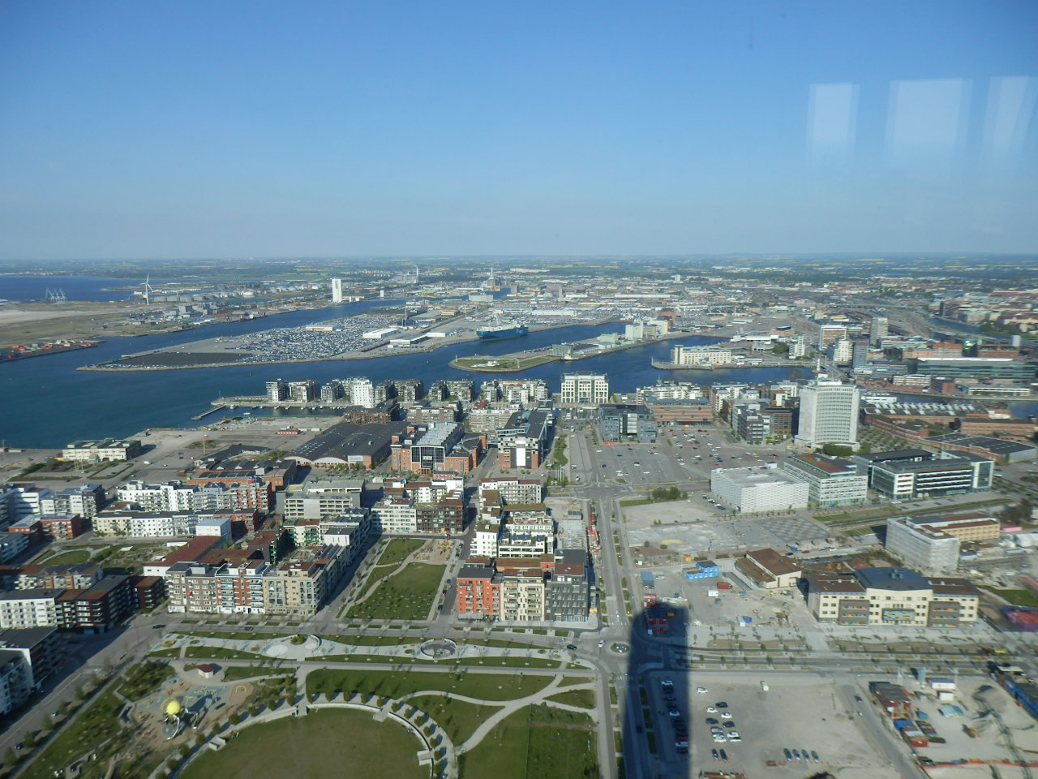
Generally good air quality in Swedish cities is due at least in part to these comparatively very low transport emissions.

Slide 36
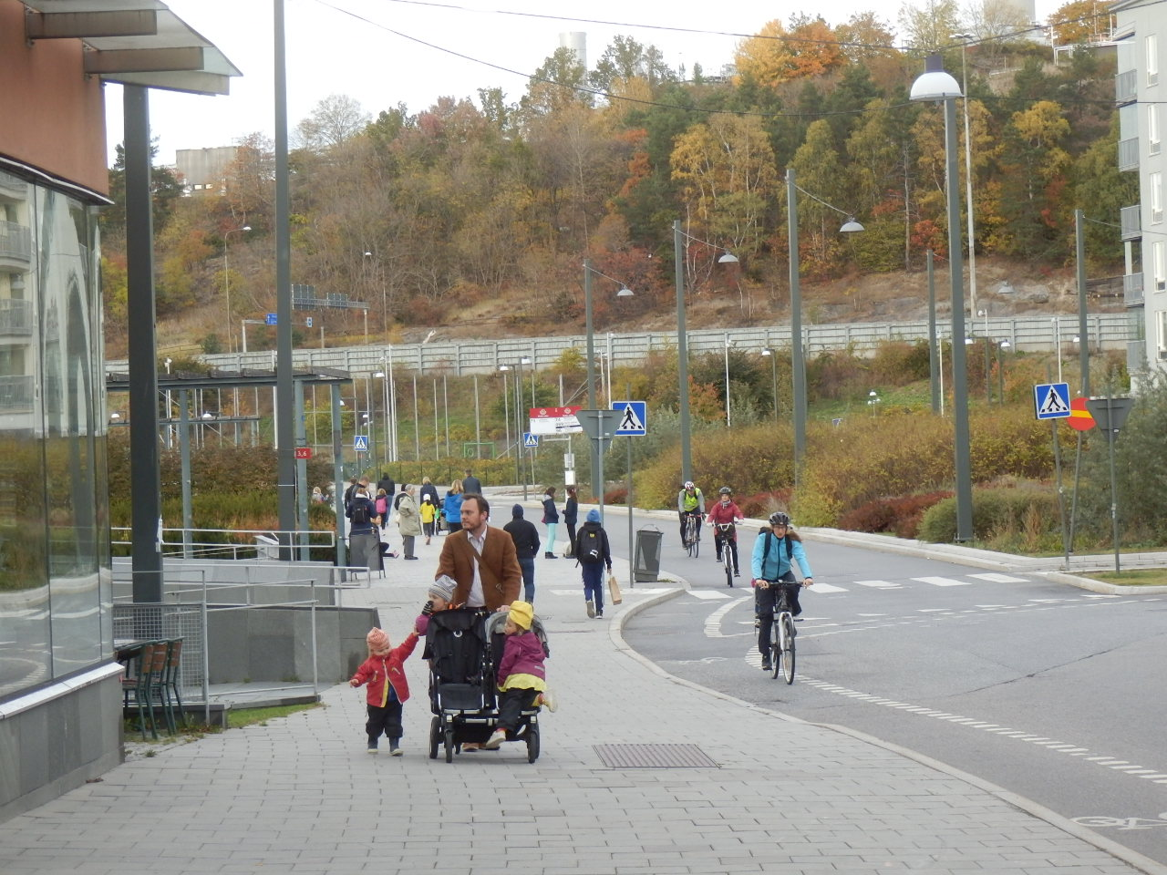
Swedish cities lead the world in low transport deaths per 100,000 people (2.4) with the larger cities at 1.6 and the smaller cities double that at 3.3. The range is 4.5 in Jönköping and 0.7 in Linköping. Freiburg achieves a reasonably good result too, but is almost double the rate of death as in Swedish cities. A five-year moving average would be better to measure this factor to iron out fluctuations.

Slide 37
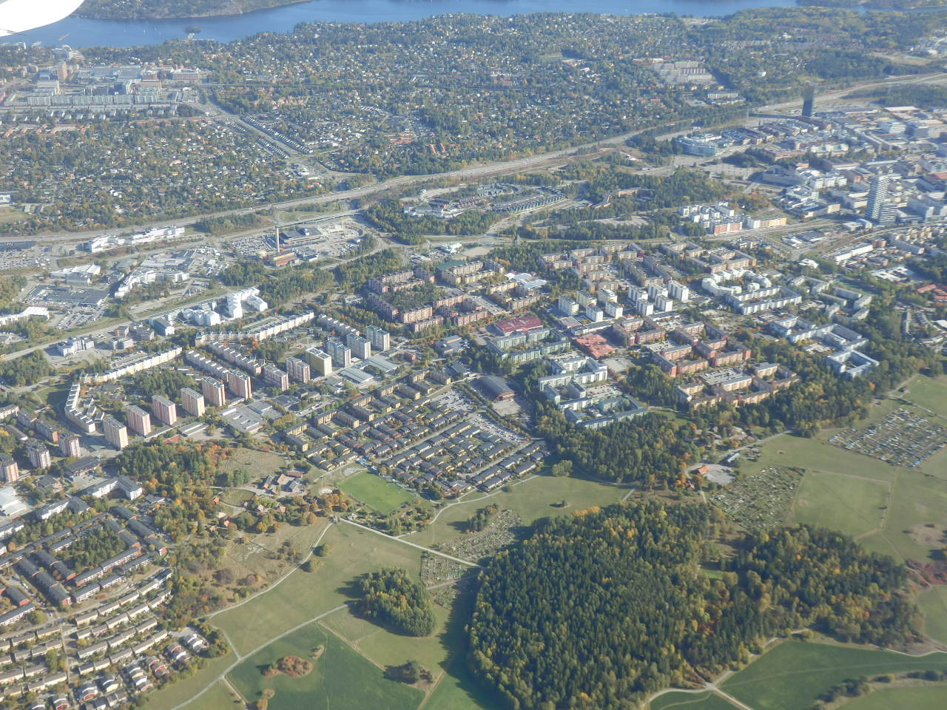
The ten Swedish cities appear to be outliers in the general relationship between urban density and car use, having only moderate car dependence in the context of their overall comparatively lower densities.
The ten Swedish cities

Slide 38
CONCLUSIONS: THE TEN SWEDISH CITIES AS A GROUP (1)
The ten Swedish cities form a unique group within the range of global cities. They present a number of interesting comparative results and indeed some paradoxical results:
• Swedish cities are significantly lower in density than other European cities and on average are a little above US and Australian large city densities.
• GDP per capita is significantly below other European cities (2005), but in 2015 was much higher than in Freiburg in Germany.
• Their car use is a bit above 1/2 Australian and 1/3 American levels and essentially the same as Freiburg (which is 2.7 times as dense) and their car ownership is 1/3 of the US and Australia.
• They are also still comparatively centralised in their CBD jobs (17.3% of total jobs), which assists transit and to a degree walking and cycling to work, especially in the smaller cities (c.f. 12.7% Aust. and 8.2% US).
• They have very good transit route coverage for their low density, high provision of reserved transit rights-of-way, very good overall speed competitiveness with cars, a bit lower per capita levels of transit service (seat km) than European cities, but three times that of US cities.
• Boardings per capita on transit are, however, only 1/3 European cities but double that of lower density auto-dependent regions. Public transport PKT per capita compares better (2.5 times auto-cities) probably due to longer transit travel distances in low density areas.
• Rail boardings per capita (44) are 1/5 compared to other European cities (240) except in Stockholm (214).
• Public transport farebox revenue and costs per passenger km are comparable to other cities around the world, but overall their cost recovery ratio (43%) is less than other European cities (60%), but better than US and AUS cities (34%). This aligns with their comparative public transport use.
• Swedish cities on average spend less of their metropolitan GDPs on public transport operating costs (1.05%) compared to other European cities (1.50%), but significantly more than in the US or Canada.

Slide 39
CONCLUSIONS: THE TEN SWEDISH CITIES AS A GROUP (2)
• Walking and cycling is on average very healthy (30.0% of daily trips) considering their lower density (US, CAD and AUS cities averages 11.7%). This appears mainly due to smaller size and significant areas of walking and transit city fabric with higher densities and mixed land use, despite overall lower density.
• Freeway supply is very high (e.g. 3.8 times Freiburg), which may also help to explain the relatively high bus average speeds (30.3 km/h) compared to all other cities (21.5 km/h). This in one way assists transit competitiveness, but in another works against it.
• Working somewhat against auto-dependence and in favour of transit, walking and cycling, Swedish cities have moderate parking in their CBDs (289/1000 jobs c.f. US 487/1000), but 16% higher than other European cities.
• Transport deaths per 100,000 and transport emissions per capita are the lowest in the global sample.
• A priority for Swedish cities would be to limit low density urban expansion, especially in the smaller cities and increase densities and mixed land uses, mainly through more Transit-Oriented Development (TOD), especially around rail stations (like in Stockholm) and major bus terminals
• Another key need is to increase the amount of rail and rail usage to bolster transit effectiveness (in combination with the TOD, this could include radial and circular Light Rail services to develop more transit-oriented urban forms). New rail in high density areas.
• Swedish cities should build on their already good walking and cycling performance by aggressively providing as much high quality infrastructure, integration with buses and trains and further protection and incentives for these modes.
• Finally, Swedish cities need to stop building any freeways and consider even removing some.

Slide 40
How Do The Five Smaller Swedish Cities Differ From The Five Larger Swedish cities?
Smaller Swedish cities are quite similar to larger Swedish cities in that they:
• Are only 4% higher in car ownership and car use per capita and private transport energy use per capita
• Have similarly centralised work (18.3% of jobs in the CBD compared to 16.3%)
• Are a moderate 10% higher in freeway length per capita.
• Have a 10% inferior public transport speed ratio compared to cars
• Have a percentage of total motorised passenger km on public transport that is 21.5% c.f. 20.4%
• Have the same average farebox revenue passenger km
• Have a moderate 13% higher operating cost per PKT
• Have an operating cost recovery which is is 40% c.f. 46%
• Only 11% less transport emissions per capita
Smaller Swedish cities have interesting differences to the larger Swedish cities in that they:
• Have 30% lower density
• Are 18% less wealthy
• Have 35% more parking per 1000 CBD jobs
• Have 34% lower seat km of public transport service per capita
• Have only 9.3% of daily trips by public transport c.f. 19.4%
• Have 32.8% of daily trips by walking and cycling versus 27.1%
Smaller Swedish cities are greatly different from the larger Swedish cities in that they:
• Have 3.6 times more reserved public transport route per capita
• Have 4.7 times higher ratio of reserved public transport route compared to freeways
• Are 69% lower in public transport boardings per capita
• Have 89% less rail boardings per capita
• Are 45% less in their public transport passenger km per capita
• Have half as much of their GDP spent on public transport operating costs
• Are double in transport deaths per 100,000 persons (but still very low)
• Half as much of their GDP is spent on public transport operating

